Slide 1
Cloud Infrastructure and Management
Prof Rajiv Misra IIT Patna
Date: 06-04-2022

Slide 2
Contents of Lecture
What is a Data Center?
Servers
Softwares
Networking devices
Storage solutions
Managing the infrastructure
Monitoring the infrastructure

Slide 3
Data Centers
Server Virtualization

Slide 4
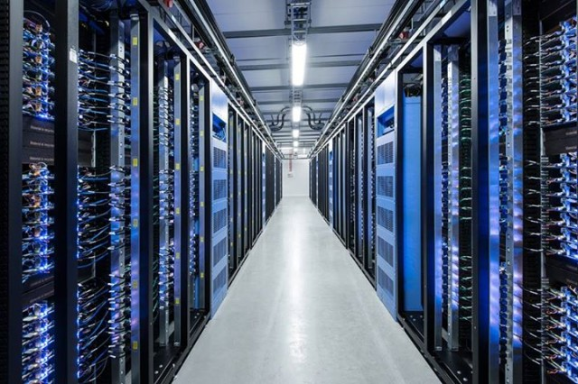

Slide 5
Cloud Data Center :
On-Premises Data Center
An on-prem data center simply means that the organization maintains all of the IT infrastructure needed by the business on-site.
An on-prem data center includes everything from the servers that support web and email to the networking hardware connecting them to support infrastructure equipment like uninterruptible power supplies (UPS).
Cloud Data Center?
A cloud data center moves a traditional on-prem data center off-site. Instead of personally managing their own infrastructure, an organization leases infrastructure managed by a third-party partner and accesses data center resources over the Internet.
Under this model, the cloud service provider is responsible for maintenance, updates, and meeting service level agreements (SLAs) for the parts of the infrastructure stack under their direct control.

Slide 6
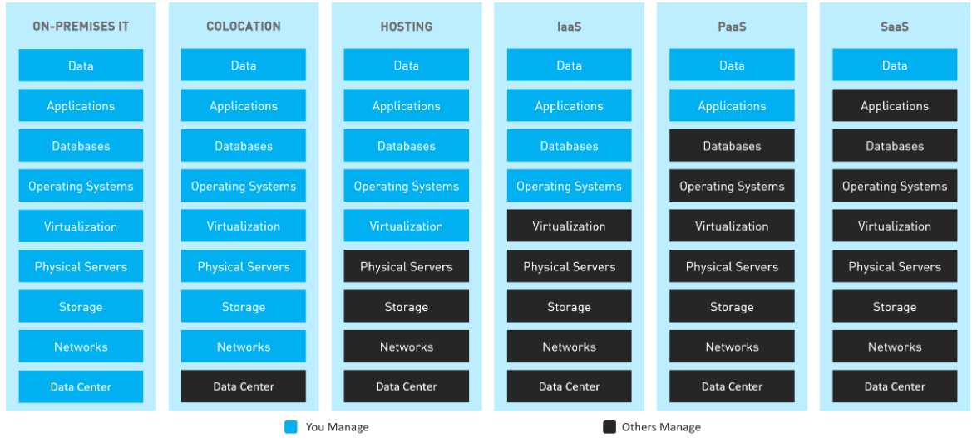
Cloud Data Center: Hybrid Cloud:Shared Responsibility Model
The migration from an on-premises data center to a cloud data center doesn’t mean moving everything to the cloud. Many companies have hybrid cloud data centers which have a mix of on-premises data center components and virtual data centers components. In the figure below we see how as-a-service models are shifting ownership of data center and infrastructure components from a fully owned and operated on-premises facility towards a commodity service model. Depending on the model selected, an organization may be responsible for maintaining and securing more or less of their infrastructure stack. The breakdown of responsibilities is outlined by the cloud services provider in shared responsibilities models

Slide 7
On-Premises Data Centers vs Cloud Data Centers
Nearly all organizations now have at least some of their infrastructure hosted in the cloud. The reason for this is that cloud data centers offer a number of advantages over maintaining an on-prem data center. Some of the pros and cons of cloud-based vs. on-premises data centers include:
Scalability: In an on-premises data center, resource scalability is limited by the infrastructure that the company has purchased and deployed. In the cloud, additional resources can be quickly and easily spun up as needed.
Flexibility: In an on-premises data center, resource flexibility is limited by the need to acquire, provision, or update appliances. In the cloud, a customer can spin up or take down resources quickly to meet business needs.
Cost: Maintaining an on-prem data center is more expensive than a cloud-based one. On-prem, an organization pays full price for all of their infrastructure. In the cloud, resources can be shared, and cloud service providers can take advantage of economies of scale.
Availability: In an on-premises data center, an organization has complete control over their infrastructure, which can be good or bad. In the cloud, availability is protected by service level agreements, which may provide better guarantees than an organization can in-house.
Security: In the cloud, the cloud service provider is responsible for securing part of an organization’s infrastructure stack and is likely more practiced at doing so. However, some customers may want additional security of their cloud-based data centers that are not natively provided by the cloud service provider.
Accessibility: In an on-prem data center, the organization has complete control over the systems that it deploys and uses. In the cloud, the organization is limited to what is offered by the service provider.

Slide 8
Cloud Servers vs Dedicated Servers
Cloud servers can be configured to provide levels of performance, security and control similar to those of a dedicated server. But instead of being hosted on physical hardware, they reside in a shared “virtualized” environment that’s managed by your cloud hosting provider.
You benefit from the economies of scale of sharing hardware with other customers. And, you only pay for the exact amount of server space used. Cloud servers also allow you to scale resources up or down, depending on demand, so that you're not paying for idle infrastructure costs when demand is low.
With cloud servers, you can optimize IT performance without the huge costs associated with purchasing and managing fully dedicated infrastructure. Businesses with variable demands and workloads often find that cloud servers are an ideal fit.
A dedicated server is a physical server that is purchased or rented entirely for your own business needs. Dedicated servers are typically used by large businesses and organizations that require exceptionally high levels of data security, or organizations that have steady, high demands for server capacity.
With dedicated servers, businesses still need the IT capacity and expertise to manage ongoing maintenance, patches and upgrades. Businesses using I/O-heavy applications, such as databases and big data platforms, find significant value in bare metal dedicated hardware.

Slide 9
open source software for cloud computing
The question used to be, “What container orchestration platform are you using?” Now the question is, “So, how are you running Kubernetes?” The past year has seen Kubernetes continue its domination, with managed “K8s” clusters being offered by all three major cloud providers, and lots of innovation happening in the surrounding ecosystem. Our 2018 Bossie winners in cloud computing are ushering in the new era of cloud-native applications.

Slide 10
Kubernetes
There was a time when other options were considered for container orchestration. But when it comes to running distributed containerized applications today, Kubernetes has consolidated its dominance. If you’re going to deploy a new scalable service across AWS, Azure, GCP, or your private cloud, Kubernetes is likely going to enter the conversation.
Building any container infrastructure means supporting a whole ecosystem of hardware, software, and network devices. With the Kubernetes 1.11 release, Kubernetes now supports IPVS in-cluster load balancing and CoreDNS (a pluggable DNS server). This follows major security, storage, and networking enhancements earlier in the year.
Istio

Slide 11
Docker
Docker allows you to package your software in “containers” and run them as an OS-level virtual machine. As opposed to VMware and other popular virtualization technologies, Docker doesn’t waste CPU or other resources virtualizing a whole computer, or require an additional OS for each “guest.” In just five short years Docker has totally changed the way virtualization works in computing.
With the ascension of Kubernetes, Docker is no longer the way most people are looking to distribute containers. However, Docker is certainly still a viable alternative for managing container clusters, and it continues to be the way most people create and run individual containers.

Slide 12
Cloud Storage
when we select a cloud storage service, we should consider some essential features such as service security, privacy, mobile app, pricing, complexity, and speed.
Some of the most popular cloud storage providers are Apple (iCloud), Amazon (Amazon Web Services ), Dropbox, and Google
How does cloud storage work?
Cloud storage works on a client-server model, in which a client sends the request to the subscribed cloud service storage and the server at the data center gives the appropriate response.
The main objective of the cloud, instead of saving data at local storage, the data of the user can be collected at some data center so the user could retrieve his or her data from any device.
What if the data center of the cloud service provider collapses or gets destroyed, would the user data also be destroyed? The answer is no.
The cloud storage depends on hundreds of data centers, so even if one of the data centers collapses, there are hundreds of centers that would help you to retrieve and save your data.

Slide 13

What is a Data Center?
“A facility used to house computer systems and associated components.” (Wikipedia)
“It is the brain of a company and the place where the most critical processes are run.” (SAP)
“It is a factory that transforms and stores bits.”
(Albert Greenberg - Microsoft)
Collection of physical compute, storage, and network resources.
Notes:
Data centers are grown by large companies and organizations(educational, guvernamental)

Slide 14
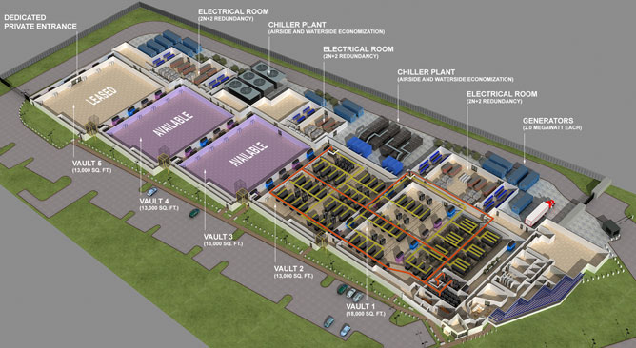
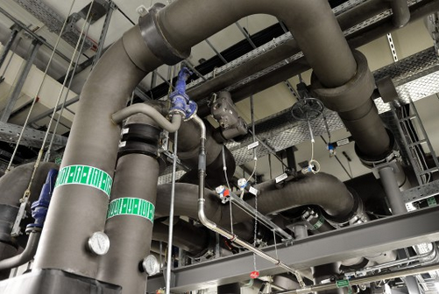
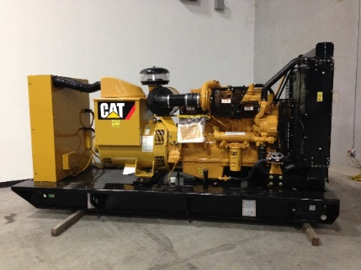
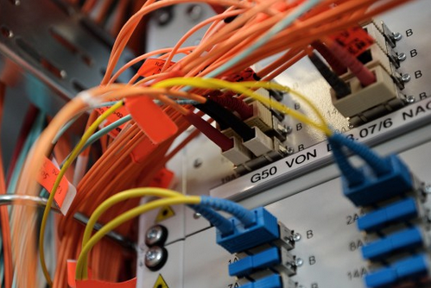
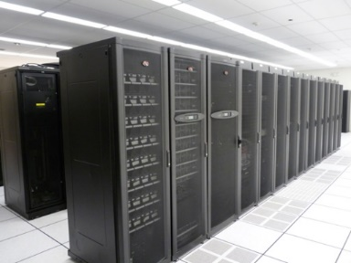
The Data Center in a nutshell
Cooling; in generous proportions
Diesel Generators
Highly connected: fiber optic cables
10’s to 100’000s
servers
WholeSale Data Center - Virginia
Notes:
Rows of server racks; an entire data center can host from 10’000s to 100’000s servers, where the electrical power and economies of scale determine total data center size

Slide 15
Data Centers Challenges
Large-scale
- 10’s to 100’s of thousands of servers
- high bandwidth and low latency is critical
Security and performance isolation
- controlled access to infrastructure
- secure the data
Availability and high performance
- 99.99X% availability
- redundancy of all critical components
Complexity
- plethora of components
- plethora of software and hardware
failures
Notes:
: Load Balancers, DNS, BGP, operating system, middleware, servers, racks, …

Slide 16
Anatomy of a Data Center
Internet
Data Center
Core Switch
Aggregation
Switches
Typical physical network
topology is a tree (3-tier Architecture)
Top of Rack
(TOR) Switch
Rack with Servers
Rack with Servers
Rack with Servers
Notes:
Three-tier is unable to handle the growing demand of cloud computing. The higher layers of the three-tier DCN are highly oversubscribed. Moreover, scalability is another major issue in three-tier DCN.
Major problems include scalability, fault tolerance, energy efficiency, cross-sectional bandwidth.
Current DC architectures to be able to scale leverages specialized hardware and communication protocols, such as InfiniBand or Myrinet. These solutions can scale to clusters of thousands of nodes with high bandwidth. However, expensive infrastructure and incompatible with TCP/IP applications
OR, you can leverage commodity Ethernet switches and routers to interconnect cluster machines. It offers backwards compatibility with existing infrastructure, low-cost. However, aggregate cluster bandwidth scales poorly with cluster size , and achieving the highest levels of bandwidth incurs non-linear cost increase with cluster size

Slide 17
Anatomy of a Data Center
Internet
Common traffic patterns
Data Center
North-south
- common with web sites
Core Switch
Aggregation
Switches
East-West
- common with back-end of
web sites/ web services
- common in Big Data
Top of Rack
(TOR) Switch
Many-to-one
- causes TCP incast
Rack with Servers
Rack with Servers
Rack with Servers
Notes:
Three-tier is unable to handle the growing demand of cloud computing. The higher layers of the three-tier DCN are highly oversubscribed. Moreover, scalability is another major issue in three-tier DCN.
Major problems include scalability, fault tolerance, energy efficiency, cross-sectional bandwidth.
Current DC architectures to be able to scale leverages specialized hardware and communication protocols, such as InfiniBand or Myrinet. These solutions can scale to clusters of thousands of nodes with high bandwidth. However, expensive infrastructure and incompatible with TCP/IP applications
OR, you can leverage commodity Ethernet switches and routers to interconnect cluster machines. It offers backwards compatibility with existing infrastructure, low-cost. However, aggregate cluster bandwidth scales poorly with cluster size , and achieving the highest levels of bandwidth incurs non-linear cost increase with cluster size

Slide 18
Anatomy of a Data Center
What are the challenges with this design?
Internet
Data Center
Core Switch
Aggregation
Switches
Single point of failure
- redundancy increase costs
Links higher in topology are oversubscribed¹
- cannot handle all servers
sending at maximum rate
- design tradeoff to scale
Top of Rack
(TOR) Switch
Rack with Servers
Rack with Servers
Rack with Servers
¹Oversubscription ratio: capacity of links below a switch relative to capacity of links above
Notes:
Three-tier is unable to handle the growing demand of cloud computing. The higher layers of the three-tier DCN are highly oversubscribed. Moreover, scalability is another major issue in three-tier DCN.
Major problems include scalability, fault tolerance, energy efficiency, cross-sectional bandwidth.
Current DC architectures to be able to scale leverages specialized hardware and communication protocols, such as InfiniBand or Myrinet. These solutions can scale to clusters of thousands of nodes with high bandwidth. However, expensive infrastructure and incompatible with TCP/IP applications
OR, you can leverage commodity Ethernet switches and routers to interconnect cluster machines. It offers backwards compatibility with existing infrastructure, low-cost. However, aggregate cluster bandwidth scales poorly with cluster size , and achieving the highest levels of bandwidth incurs non-linear cost increase with cluster size

Slide 19

Anatomy of a Data Center
Can we achieve full bisection bandwidth?
(oversubscription ratio of 1:1)
Partially, because …
- requires enterprise-level switches
- even they become saturated at large scale
Notes:
Three-tier is unable to handle the growing demand of cloud computing. The higher layers of the three-tier DCN are highly oversubscribed. Moreover, scalability is another major issue in three-tier DCN.
Major problems include scalability, fault tolerance, energy efficiency, cross-sectional bandwidth.
Current DC architectures to be able to scale leverages specialized hardware and communication protocols, such as InfiniBand or Myrinet. These solutions can scale to clusters of thousands of nodes with high bandwidth. However, expensive infrastructure and incompatible with TCP/IP applications
OR, you can leverage commodity Ethernet switches and routers to interconnect cluster machines. It offers backwards compatibility with existing infrastructure, low-cost. However, aggregate cluster bandwidth scales poorly with cluster size , and achieving the highest levels of bandwidth incurs non-linear cost increase with cluster size

Slide 20
Can we do better?

Slide 21
Emerging data center topology – Fat Trees
Goals:
- use cheap identical commodity switches
- provides redundancy
- help address large volumes of data
- provides full bisection bandwidth
the bottleneck is the network interface,
not the link in the network
Notes:
Three-tier is unable to handle the growing demand of cloud computing. The higher layers of the three-tier DCN are highly oversubscribed. Moreover, scalability is another major issue in three-tier DCN.
Major problems include scalability, fault tolerance, energy efficiency, cross-sectional bandwidth.
Current DC architectures to be able to scale leverages specialized hardware and communication protocols, such as InfiniBand or Myrinet. These solutions can scale to clusters of thousands of nodes with high bandwidth. However, expensive infrastructure and incompatible with TCP/IP applications
OR, you can leverage commodity Ethernet switches and routers to interconnect cluster machines. It offers backwards compatibility with existing infrastructure, low-cost. However, aggregate cluster bandwidth scales poorly with cluster size , and achieving the highest levels of bandwidth incurs non-linear cost increase with cluster size

Slide 22
Emerging data center topology – Fat Trees
Main idea: inter-connect racks using a fat-tree topology
E.g.: given K-ports identical switches, where K = 4:
Challenges
Core
More switches than the
tree topology
Aggregation
Different routing approach
Edge
Does not solve TCP incast
Pod 0
Pod 1
Pod 2
Pod 3
Notes:
Three-tier is unable to handle the growing demand of cloud computing. The higher layers of the three-tier DCN are highly oversubscribed. Moreover, scalability is another major issue in three-tier DCN.
Major problems include scalability, fault tolerance, energy efficiency, cross-sectional bandwidth.
Current DC architectures to be able to scale leverages specialized hardware and communication protocols, such as InfiniBand or Myrinet. These solutions can scale to clusters of thousands of nodes with high bandwidth. However, expensive infrastructure and incompatible with TCP/IP applications
OR, you can leverage commodity Ethernet switches and routers to interconnect cluster machines. It offers backwards compatibility with existing infrastructure, low-cost. However, aggregate cluster bandwidth scales poorly with cluster size , and achieving the highest levels of bandwidth incurs non-linear cost increase with cluster size

Slide 23
How do we make use
of Data Centers?

Slide 24

Cloud Computing
17

Slide 25
What is Cloud Computing?
Delivery of on-demand shared computing resources – everything from applications, services to compute, storage and network resources.

Slide 26

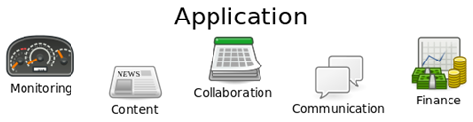
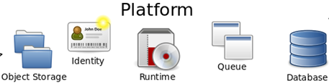
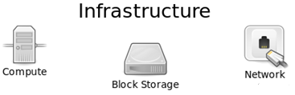
What is Cloud Computing?
Data Center
Hardware/software of the data center implements the Cloud
Cloud

Slide 27
Cloud Computing – Key Characteristics
Virtualized Resources
- physical resources divided into pieces
- each customer gets an isolated piece
On-demand
- customers can request/release
resources whenever they want
Rapid elasticity
- capabilities can be elastically
provisioned/released
Resilient
- multiple pools of resources that are
unlikely to fail simultaneously
Pay-per-use
- only pay for the resources you use
Shared
- multiple customers share the same
physical resources

Slide 28
Cloud Computing
The Cloud Computing Stack organizes the hardware/software into various layers
Data Center
Hardware/software of the data center implements the Cloud
Cloud
Cloud Computing Stack
The various types of Clouds all have a Cloud Computing Stack backed by a data center

Slide 29

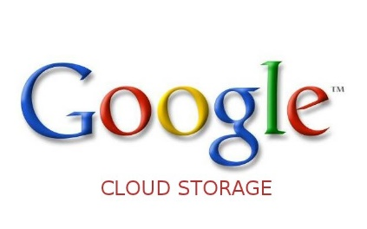
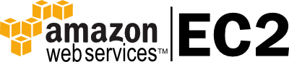
Cloud Computing – Categories
IaaS
- customers lease virtual machines,
virtual storage, virtual networks
- customers must manage operating
system, file system, etc..
Hosted Applications
Suites of Services
Development Tools and Database Management
Operating Systems
Virtualization
IaaS
Servers and Storage
Networking
Firewalls/Security
Data Center
Physical Plant/Building
Cloud Computing Stack

Slide 30

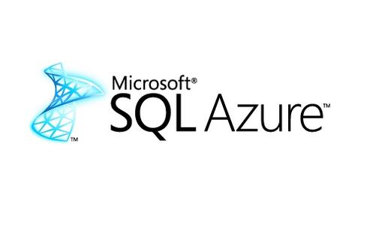
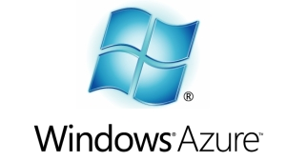

Cloud Computing – Categories
PaaS
- customers lease resources to run
applications written in a specific language
such as Python, Java, MapReduce
- cloud provider manages the operating
system, file system, and network
Hosted Applications
Suites of Services
Development Tools and Database Management
Operating Systems
Virtualization
PaaS
Servers and Storage
Networking
Firewalls/Security
Data Center
Physical Plant/Building
Cloud Computing Stack

Slide 31

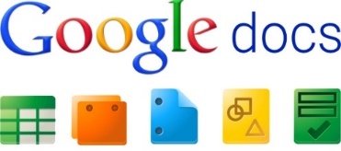
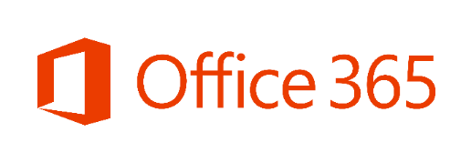

Cloud Computing – Categories
SaaS
- customers lease machines that run
specific software
- it is what most people mean when they
say the “Cloud”
Hosted Applications
Suites of Services
Development Tools and Database Management
Operating Systems
SaaS
Virtualization
Servers and Storage
Networking
Firewalls/Security
Data Center
Physical Plant/Building
Cloud Computing Stack

Slide 32
Cloud Computing – Deployment Models
Private Cloud
- only available to users (e.g. departments) within a company or organization
Public Cloud
- anyone can request and use the cloud
Hybrid Cloud
- a composition of public and private cloud resources
- bounded by standardized or proprietary technology

Slide 33
Server Virtualization
Server Virtualization

Slide 34
Cloud Computing depends on Server Virtualization
In the context of server virtualization, how do we network the large number of VMs that might reside on a single physical server? Cloud computing depends heavily on server virtualization for several reasons:
(i) Sharing of physical infrastructure: Virtual machines allow multiplexing of hardware with tens to 100s of VMs residing on the same physical server. Also, it allows rapid deployment of new services.
(ii) Spinning up a virtual machine in seconds: Spinning up a virtual machine might only need seconds compared to deploying an app on physical hardware, which can take much longer.
(ii) Live VM migration: Further, if a workload requires migration. For example, you do physical server requiring maintenance. This can be done quickly with virtual machines, which can be migrated to other servers without requiring interruption of service in many instances. Due to these advantages today, more endpoints on the network are virtual rather than physical.
Server Virtualization

Slide 35
Server Virtualization
The physical hardware is managed by a Hypervisor. This could be Xen, KVM, or VMWare's ESXI, or multiple such alternatives.
On top of the Hypervisor runs several VMs in user space.
The hypervisor provides an emulated view of the hardware to the VMs, which the VMs treat as their substrate to run a guest OS on.
Among other hardware resources the network interface card is also virtualized in this manner. The hypervisor managing the physical NIC, is exposing virtual network interfaces to the VMs. The physical NIC also connects the server to the rest of the network.
VM1
VM2
VMN
virtual NIC
vNIC
vNIC
vNIC
Hypervisor
Physical NIC
pNIC
Physical switch
pSwitch
Server Virtualization

Slide 36
Networking of VMs inside the Hypervisor
The hypervisor runs a virtual switch, this can be a simple layer tool searching device, Operating in software inside the hypervisor.
vSw is connected to all the virtual NICs, has them as the physical NIC, and moved packets between the VMs and the external network.
Alternate Methods of virtualization:
(i) Using Docker
(ii) Using Linux containers
VM1
VM2
VMN
virtual switch
vNIC
vNIC
vNIC
Hypervisor
vSw
pNIC
pSwitch
Server Virtualization

Slide 37
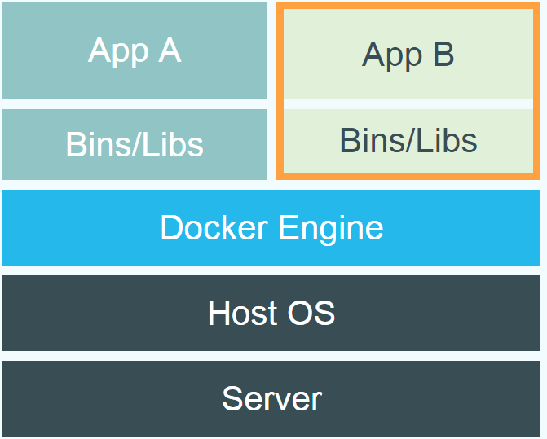
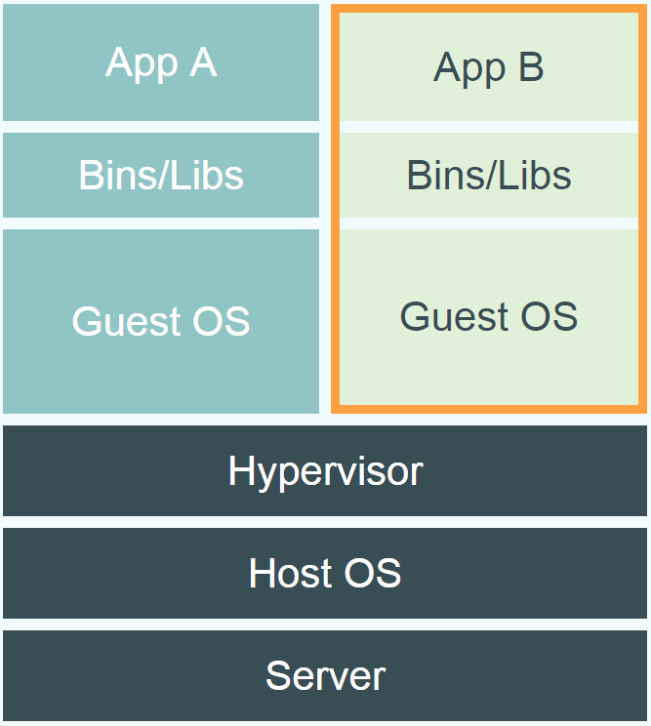
Docker
Docker is an open-source project that automates the deployment of applications inside software containers, by providing an additional layer of abstraction and automation of OS–level virtualization on Linux.
The Docker Engine container comprises just the application and its dependencies.
It runs as an isolated process in userspace on the host operating system, sharing the kernel with other containers. Thus, it enjoys the resource isolation and allocation benefits of VMs but is much more portable and efficient.
Docker
Virtual Machine
Server Virtualization

Slide 38
(i) Using VMs as Virtualization
Application
In this model, each VM runs its own entire guest OS. The application runs as a process inside this guest OS.
This means that even running a small application requires the overhead of running an entire guest OS.
OS
VM2
VMN
vNIC
vNIC
vNIC
Hypervisor
pNIC
pSwitch
Server Virtualization

Slide 39
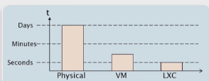
Linux containers as Virtualization
Create an environment as close as possible to a standard Linux without separate kernel
Uses kernel features for separation
Near bare metal (physical hardware) performance
Fast provisioning times (Building up/start-up time)
Container
Container
Container
Host OS
Server Virtualization

Slide 40
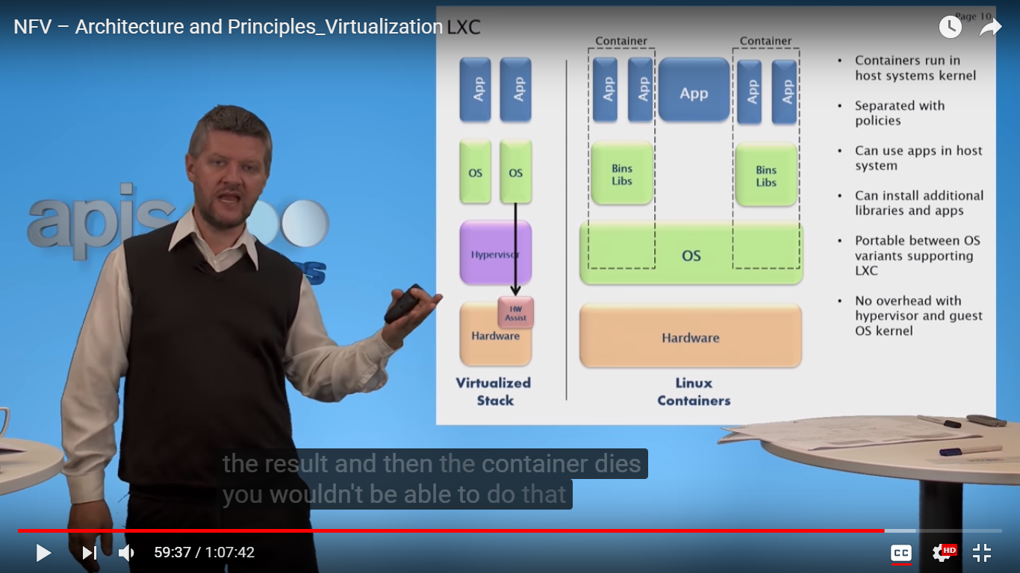
Linux containers
Containers run in host systems kernel
Separated with policies
Can use apps in host system
Can install additional libraries and apps
Portable between OS variants supporting linux container
No overhead with hypervisor and guest OS kernel
Server Virtualization

Slide 41
(ii) Using Linux containers
In this approach, an application together with its dependencies uses packages into a Linux container, which runs using the host machine's Linux stack and any shared resources.
Docker is simply a container manager for multiple such containers. Applications are isolated form each other by the use of separate namespaces. Resources in one application cannot be addressed by other applications. This yields isolation quite similar to VMs, but with a smaller footprint.
Further, containers can be brought up much faster than VMs. Hundreds of milliseconds as opposed to seconds or even tens of seconds with VMs.
Container
Application
…
Linux
Docker
pNIC
pSwitch
Server Virtualization

Slide 42
Kubernetes: Definition
Kubernetes (K8S) is an open source software tool for managing containerized
workloads.
● It operates at the container (not hardware) level to automate the deployment, scaling
and management of applications.
● K8s works alongside a containerisation tool, like Docker. So if containers are the
‘ingredients’ of an application, then K8S would be the ‘chef’.
● As well as managing individual containers, K8s can also manage clusters.
○ A cluster is a series of servers connected to run containers.
○ K8s can scale up to 5,000 servers and 150,000 pods in a single cluster.
○ A pod is a group of containers that share resources, a network and can
communicate with one another.

Slide 43
How Does Kubernetes Work?
Kubernetes has a master-slave architecture:
2. Master Node (master) - This controls the
deployment. This node contains:
a. API server - this receives inputs
from the User Interface (UI) or
Command Line Interface (CLI).
b. Controller - uses information from
the API to drive the application from
its current state towards the desired
state provided.
c. Scheduler
d. Etcd - handles configuration
management, service discovery etc.
1. Worker Nodes (slave) - This is
where containers are deployed.
These nodes contain:
a. Multiple pods
b. Docker engine
c. Any add-ons e.g. DNS
d. Kubelet - this is an important
component as it carries out the
instructions from the master
node.

Slide 44
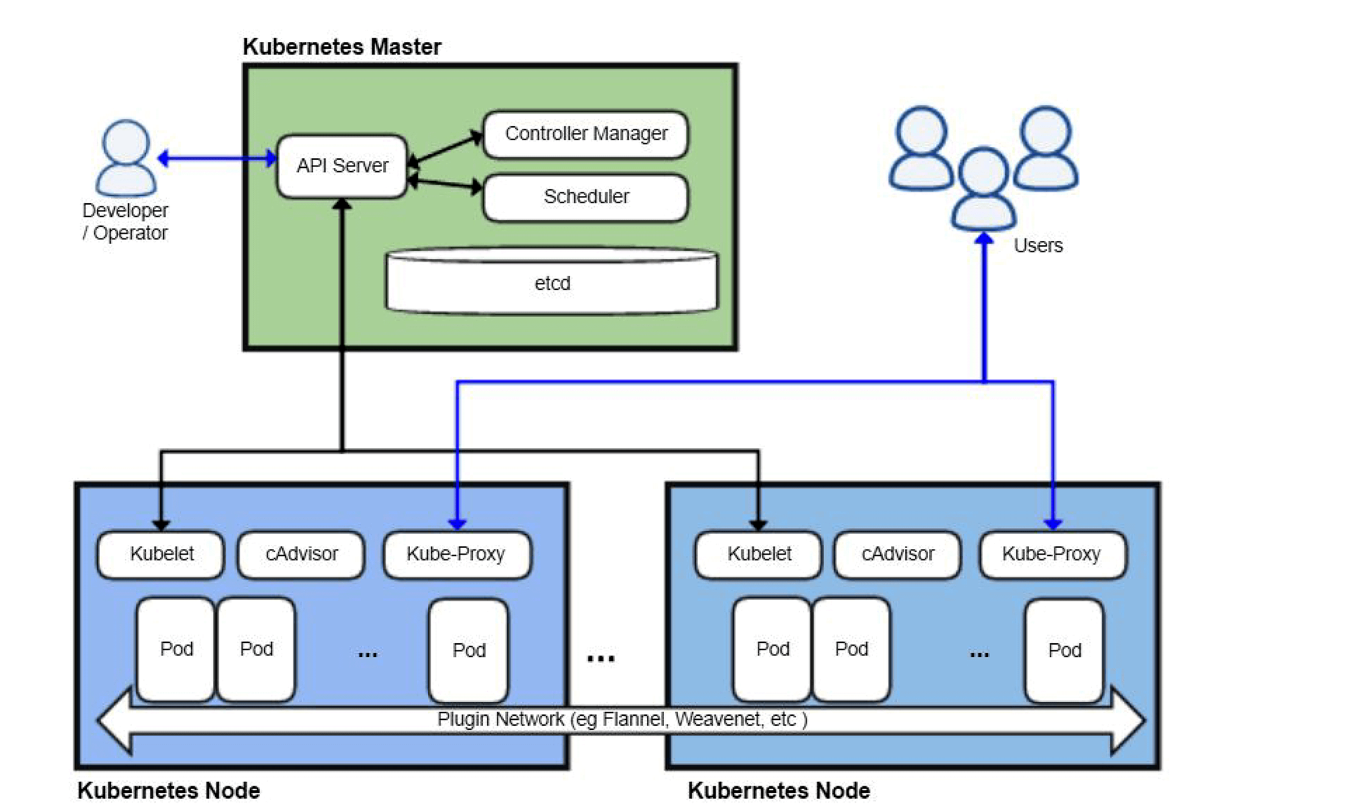
Kubernetes Architecture

Slide 45
Kubernetes Master Node
Master Node is a collection of components like Storage, Controller, Scheduler, API-server that makes up the control plan of the Kubernetes. When you interact with Kubernetes by using CLI you are communicating with the Kubernetes cluster’s master node. All the processes run on a single node in the cluster, and this node is also referred to as the master.
Master Node Components:
1) Kube API-server performs all the administrative tasks on the master node. A user sends the rest commands as YAML/JSON format to the API server, then it processes and executes them. The Kube API-server is the front end of the Kubernetes control plane.
2) etcd is a distributed key-value store that is used to store the cluster state. Kubernetes stores the file in a database called the etcd. Besides storing the cluster state, etcd is also used to store the configuration details such as the subnets and the config maps.
3) Kube-scheduler is used to schedule the work to different worker nodes. It also manages the new requests coming from the API Server and assigns them to healthy nodes.
4) Kube Controller Manager task is to obtain the desired state from the API Server. If the desired state does not meet the current state of the object, then the corrective steps are taken by the control loop to bring the current state the same as the desired state.

Slide 46
Kubernetes Worker Node
The worker nodes in a cluster are the machines or physical servers that run your applications. The Kubernetes master controls each node. there are multiple nodes connected to the master node. On the node, there are multiple pods running and there are multiple containers running in pods.
Worker Node Components
1) Kubelet is an agent that runs on each worker node and communicates with the master node. It also makes sure that the containers which are part of the pods are always healthy. It watches for tasks sent from the API Server, executes the task like deploy or destroy the container, and then reports back to the Master.
2) Kube-proxy is used to communicate between the multiple worker nodes. It maintains network rules on nodes and also make sure there are necessary rules define on the worker node so the container can communicate to each in different nodes.
3) Kubernetes pod is a group of one or more containers that are deployed together on the same host. Pod is deployed with a shared storage/network, and a specification for how to run the containers. Containers can easily communicate with other containers in the same pod as though they were on the same machine.
4) Container Runtime is the software that is responsible for running containers. Kubernetes supports several container runtimes: Docker, containers.

Slide 47
Benefits of Kubernetes
Self-healing
○ Clusters can auto-restore from errors by rolling back to the last working version of
software. This allows teams to ship quickly without the risk of breaking anything.
● High Availability
○ Clusters can be recreated on a working node to avoid downtime during server
failure.
● Simplifys Maintenance
○ If a server needs to be rebooted, or the host OS needs updating, containers can
be moved to another node whilst maintenance is carried out.
● Automatic Scaling
○ Uses information from user requests and CPU usage to increase or decrease the
number of nodes running to match demand.
● Efficient
○ Automatically spins up any new containers on under-utilized nodes.

Slide 48
Things Kubernetes does not do...
There are sometimes misconceptions about what Kubernetes can do. Kubernetes does
not…
● Provide any comprehensive machine configuration.
● Provide a configuration language/system
● Dictate logging, monitoring or alerting solution
● Build your application
● Provide middleware, data-processing frameworks, databases, caches etc. BUT these
components can run on Kubernetes

Slide 49
Networking with Docker
Each container is assigned a virtual interface. Docker contains a virtual ethernet bridge connecting these multiple virtual interfaces and the physical NIC.
Configuring Docker and the environment variables decide what connectivity is provided. Which machines can talk to each other, which machines can talk to the external network, and so on.
External network connectivity is provided through a NAT, that is a network address translator.
Container
Application
…
Linux
Docker
pNIC
pSwitch
Server Virtualization

Slide 50
Improving networking performance
The hypervisor runs a virtual switch to able to network the VM's and CPU is doing the work for moving the packets.
VM1
VM2
VMN
vNIC
vNIC
vNIC
CPU does the work!
Hypervisor
vSw
pNIC
pSwitch
Server Virtualization

Slide 51
Packet processing on CPUs
Flexible slow, CPU-expensive: Now packet processing on CPUs can be quite flexible because it can have general purpose forwarding logic. You can have packet filters on arbitrary fields run multiple packet filters if necessary, etc. But if done naively, this can also be very CPU-expensive and slow.
Packet forwarding: The packet forwarding entails: At 10Gbps line rates with the smallest packets, that's 84 Bytes. We only have an interval of 67ns before the next packet comes in on which we need to make a forwarding decision. Note that ethernet frames are 64 bytes, but together with the preamble which the tells the receiver that a packet is coming and the necessary gap between packets. The envelope becomes 84 bytes. For context a CPU to memory access takes tens of nanoseconds. So, 67 nanoseconds is really quite small.
Server Virtualization

Slide 52
Packet processing on CPUs
Need time for Packet I/O: Moving packets from the NIC buffers to the OS buffers, which requires CPU interrupts. Until recently a single X86 core couldn't even saturate a ten gigabits per second link. And this is without any switching required. This was just moving packets from the NIC to the OS. After significant engineering effort, packet I/O is now doable at those line rates. However for a software switch we need more.
Userspace overheads: If any of the switching logic is in userspace, one incurs the overhead for switching between userspace and kernel space.
Packet classification: Further, for switching we need to match rules for forwarding packets to a forwarding table. All of this takes CPU time. Also keep in mind that forwarding packets is not the main goal for the CPU. The CPU is there to be doing useful computation.
Server Virtualization

Slide 53
Approaches for Networking of VMs
There are two different approaches to address the problem of networking VMs:
(i) One, using specialized hardware:
- SR-IOV, single-root I/O virtualization
(ii) Other using an all software approach:
- Open vSwitch
Server Virtualization

Slide 54
(i) Hardware based approach
The main idea behind the hardware approach is that CPUs are not designed to forward packets, but the NIC is.
The naive solution would be to just give access to the VMs, to the NIC. But then problems arise. How do you share the NIC's resources? How do you isolate various virtual machines?
SR-IOV, single-root I/O virtualization, based NIC provides one solution to this problem.
Server Virtualization

Slide 55
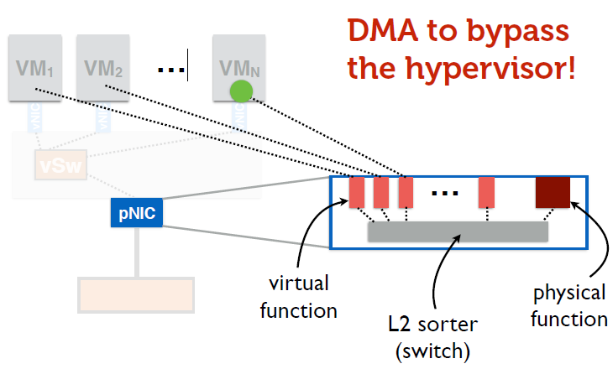
SR-IOV: Single-root I/O Virtualization
The SR-IOV, the physical link itself, supports virtualization in hardware. So let's see inside this SR-IOV enabled network interface card.
The NIC provides a physical function, which is just a standard ethernet port. In addition, it also provides several virtual functions which are simple queues that transmit and receive functionality.
Each VM is mapped to one of these virtual functions. So the VMs themselves get NIC hardware resources.
Server Virtualization

Slide 56
SR-IOV: Single-root I/O Virtualization
On the NIC there also resides a simple layer two, which classifies traffic into queues responding to these virtual functions. Further, packets are moved directly from the net virtual function to the responding VM memory using DMA (direct memory access). This allows us to bypass the hypervisor entirely.
Server Virtualization

Slide 57
SR-IOV: Single-root I/O Virtualization
The hypervisor is only involved in the assignment of virtual functions to virtual machines. And the management of the physical function, but not the data part for packets. The upshot to this is higher through-put, lower latency and lower CPU utilization and this give us close to native performance.
Server Virtualization

Slide 58
SR-IOV: Single-root I/O Virtualization
There are downsides to this approach though. For one, live VM migration becomes trickier, because now you've tied the virtual machine to physical resources on that machine. The forwarding state for that virtual machine now resides in the layer two switch inside the NIC.
Second, forwarding is no longer as flexible. We're relying on a layer two switch that is built into the hardware of the NIC. So we cannot have general purpose rules and we cannot be changing this logic very often. It's built into the hardware. In contrast, software-defined networking (SDN) allows a much more flexible forwarding approach.
Server Virtualization

Slide 59
(ii) Software based approach
The software based approach that addresses:
(i) Much more flexible forwarding approach
(ii) Live VM migration
Server Virtualization

Slide 60
Open vSwitch
Open vSwitch design goals are flexible and fast-forwarding.
This necessitates a division between user space and kernel space task. One can not work entirely in the kernel, because of development difficulties. It's hard to push changes to kernel level code, and it's desirable to keep logic that resides in the kernel as simple as possible.
VM1
VM2
VMN
vNIC
vNIC
vNIC
user space
Hypervisor
vSw
kernel
pNIC
pSwitch
Server Virtualization

Slide 61
Open vSwitch
So, the smarts of this approach, is the switch routing decisions lie in user space.
This is where one decides what rules or filters apply to packets of a certain type. Perhaps based on network updates from other, possibly virtual, such as in the network. This behavior can also be programmed using open flow. So, this part is optimized for processing network updates, and not necessarily for wire speed packet forwarding.
VM1
VM2
VMN
decision-making “smarts”
vNIC
vNIC
vNIC
user space
Hypervisor
vSw
kernel
pNIC
pSwitch
Server Virtualization

Slide 62
Open vSwitch
Packet forwarding, on the other hand, is handled largely in the kernel, broadly.
Open vSwitch approach is to optimize the common case, as opposed to the worst case line rate requirements and caching will be the answer to that need.
VM1
VM2
VMN
decision-making “smarts”
vNIC
vNIC
vNIC
user space
Hypervisor
vSw
kernel
pNIC
Simple, fast forwarding
pSwitch
Server Virtualization

Slide 63
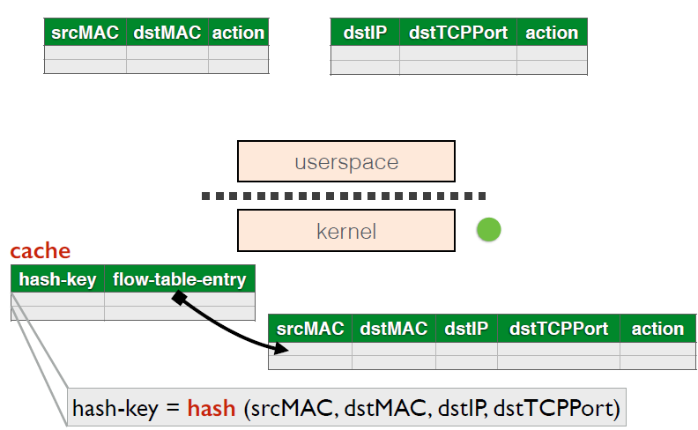
Inside Open vSwitch
The first packet of a flow goes to userspace here several different packet classifiers may be consulted. Some actions may be based on MAC addresses and some others might depend on TCP PORTs, etc.
The highest priority matching action across these different classifiers will be used to forward the packet.
Once a packet is forwarded, a collapsed rule used to forward that packet is installed in the kernel. This is a simple classifier with no priorities. The following packets of this flow will never enter user space, seeing only the kernel level classifier.
Server Virtualization

Slide 64
Inside Open vSwitch
The problem though is when it's still running a packet classifier in the kernel in software. What this means is for every packet that comes in, you are searching in this table for the right entry that matters and using that entry for forward the packet. This can be quite slow.
Open vSwitch solves this problem is to create a simple hash table based cache into the classifier. So instead of looking at this entire table and finding the right rule. You'll hash what fields are used to match packet, and the hash key is now your pointer to the action that needs to be taken. And, these hash keys and their actions can be cache.
Server Virtualization

Slide 65
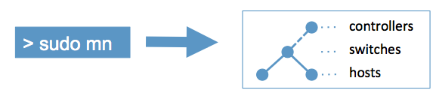
Introduction to Mininet
Mininet creates a realistic virtual network, running real kernel, switch and application code, on a single machine (VM, cloud or native), in seconds, with a single command:
It is a network emulator which creates realistic virtual network
Runs real kernel, switch and application code on a single machine
Provides both Command Line Interface (CLI) and Application Programming Interface (API)
CLI: interactive commanding
API: automation
Abstraction
Host: emulated as an OS level process
Switch: emulated by using software-based switch
E.g., Open vSwitch, SoftSwitch
Server Virtualization

Slide 66
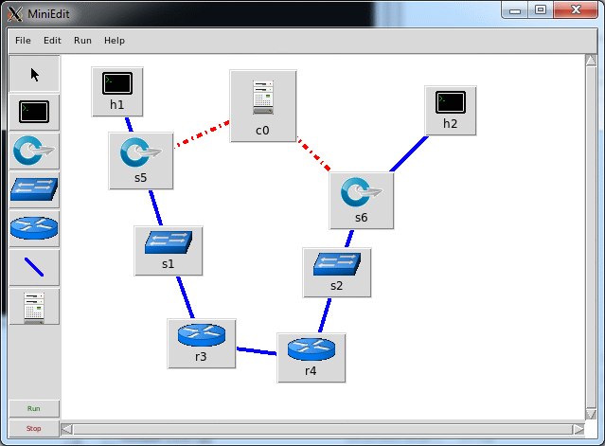
Mininet Applications
MiniEdit (Mininet GUI)
A GUI application which eases the Mininet topology generation
Either save the topology or export as a Mininet python script
Visual Network Description (VND)
A GUI tool which allows automate creation of Mininet and OpenFlow controller scripts
Server Virtualization

Slide 67
Important Links for Mininet
mininet.org
github.com/mininet
github.com/mininet/mininet/wiki/Documentation
reproducingnetworkresearch.wordpress.com
Server Virtualization

Slide 68
Comparison
The hardware based approach the SR-IOV takes sacrifices flexibility and forwarding logic for line rate performance in all scenarios. Virtually hitting native performance.
While the software based approach Open vSwitch, the compromise made is to avoid targeting worst case performance, and focusing on forwarding flexibility.
Server Virtualization

Slide 69
References
W. Felter, A. Ferreira, R. Rajamony and J. Rubio, "An updated performance comparison of virtual machines and Linux containers," 2015 IEEE International Symposium on Performance Analysis of Systems and Software (ISPASS), Philadelphia, PA, 2015, pp. 171-172.
Ben Pfaff, Justin Pettit, Teemu Koponen, Ethan J. Jackson, Andy Zhou, Jarno Rajahalme, Jesse Gross, Alex Wang, Jonathan Stringer, Pravin Shelar, Keith Amidon, and Martín Casado, “The design and implementation of open vSwitch” In Proceedings of the 12th USENIX Conference on Networked Systems Design and Implementation (NSDI'15). USENIX Association, Berkeley, CA, USA, 2015, pp. 117-130.
Server Virtualization

Slide 70
Conclusion
In this lecture, we have discussed server virtualization and also discuss the need of routing and switching for physical and virtual machines.
We have discussed two methods of virtualization: (i) Docker based and (ii) Linux container based.
To address the problem of networking VMs, two approaches are discussed: (i) One, using specialized hardware: SR-IOV, single-root I/O virtualization and (ii) Other using an all software approach: Open vSwitch
Server Virtualization

Slide 71
Software Defined Network Application to Networking in the Cloud
Software Defined Network

Slide 72
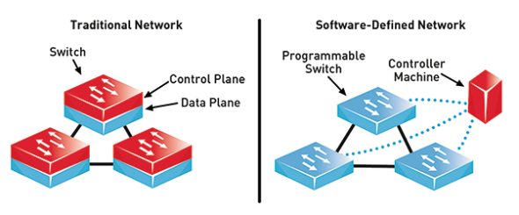
Preface
Content of this Lecture:
In this lecture, we will discuss the architecture of software defined networking and its applications to networking in the cloud.
We will also discuss the network Virtualization in multi-tenant data centers with case study of VL2 and NVP
Software Defined Network

Slide 73
Need of SDN
The traditional networking problem that SDN (software defined networking) is addressing as:
I) Complexity of existing networks
Networks are complex just like computer system, having system with software.
But worst than that it's a distributed system
Even more worse: No clear programming APIs, only “knobs and dials” to control certain functions.
II) Network equipment traditionally is proprietary
Integrated solutions (operating systems, software, configuration, protocol implementation , hardware ) from major vendors
RESULT: - Hard and time intensive to innovate new kinds of networks and new services or modify the traditional networks more efficiently.
Software Defined Network

Slide 74
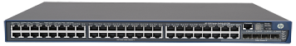
Traditional Network
In traditional network, configuring a router, for example, for BGP routing, in a configuration file.
Hundreds, thousands, tens of thousands network devices, router switches and firewalls throughout the network that will get pushed out configuration to various devices on the network.
Once it reaches a device then these configurations have to be interpreted by router software and implementation of protocols that run distributed algorithms and arrive at routing solutions that produce the ultimate behavior that's installed in the network hardware.
So here the policy is embedded into the mechanism. It means the network routing to achieve low latency or high utilization of the network that control are baked into the distributive protocol that are in standardized implementations.
Traditional Network
Configuration file
Configuration file
Device software
Device software
Device software
Device software
Device software
Device software
Software Defined Network

Slide 75
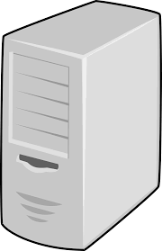
Software-defined network
The traditional software and OSs are built on layers and APIs. So it begin close to the hardware build a low level interface that gives direct access to what the network switching hardware is doing.
Then a logically centralized controller which communicates with distributed switches and other devices in the network.
The goal of a logically centralized controller is to express our goal in one location and keep the widely distributed switching gear as simple as possible.
Put the intelligence in a logically centralized location. On top of that, build software abstractions that help us to build different applications, a network operating system if you want.
app
app
Software abstractions
Network OS
Logically centralized controller
Data plane API
Software Defined Network

Slide 76
Key Ideas of SDN
Key ideas software-defined networking architecture:
Division of Policy and Mechanisms-
Low-level interface and programmatic interface for the data plane
Logically centralized controller that allows us to build software abstractions on top of it.
Software Defined Network

Slide 77
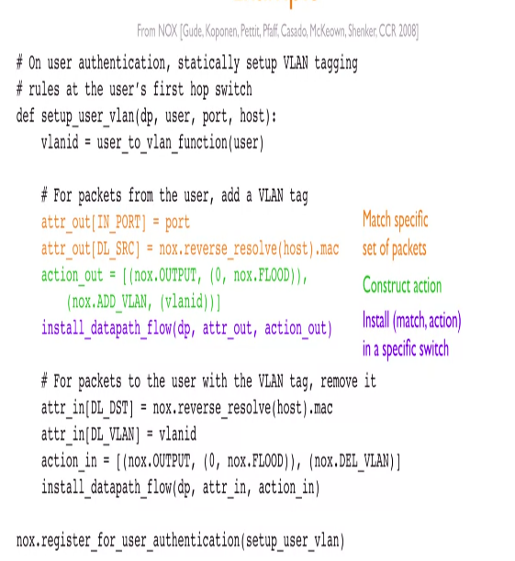
Example: NOX
NOX is a very early SDN controller. So to identify a user's traffic, a particular user or computer to send traffic through the network, and that traffic through the network is going to be tagged with an identifier, a VLAN and that identifies that user.
So to instruct the network we match a specific set of relevant packets and look at the location where this traffic comes in from as well as the MAC address. And we're going to construct an action that should happen, in this case, tagging, adding that VLAN tag to the traffic.
And then we're going to install that action on the specified set of packets in a particular switch. So we're basically telling the switch, if you see this, do that.
In addition, commonly SDN controllers have some kind of topology discovery, the ability to control traffic and monitor the behavior in the network.
Software Defined Network

Slide 78
Key Ideas of SDN
A programmatic low level interface with the data plane
Centralized control
Higher level abstractions that makes easier control.
Software Defined Network

Slide 79
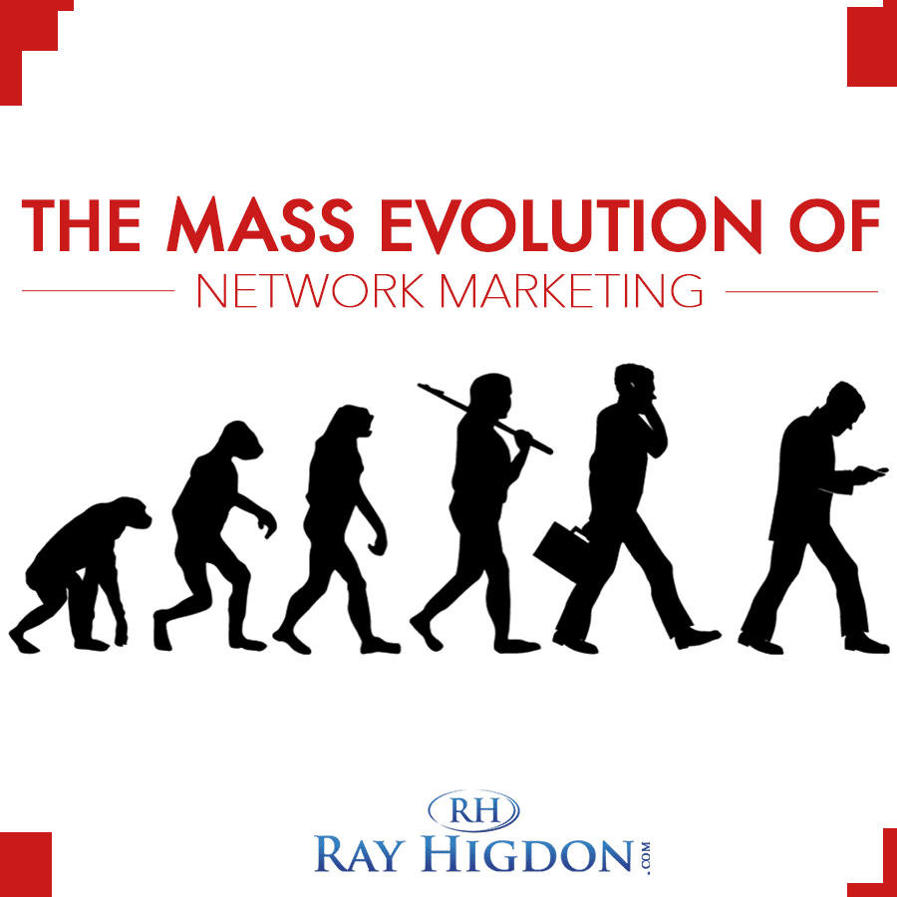
Evolution of SDN: Flexible Data Planes
Evolution of SDN is driving towards making the network flexible.
Label switching or MPLS (1997) i.e. matching labels, executing actions based on those labels adding flexibility:-
Lay down any path that we want in the network for certain classes of traffic.
Go beyond simple shortest path forwarding,
Good optimization of traffic flow to get high throughput for traffic engineering
Setting up private connections between enterprises and distributed sites.
Software Defined Network

Slide 80
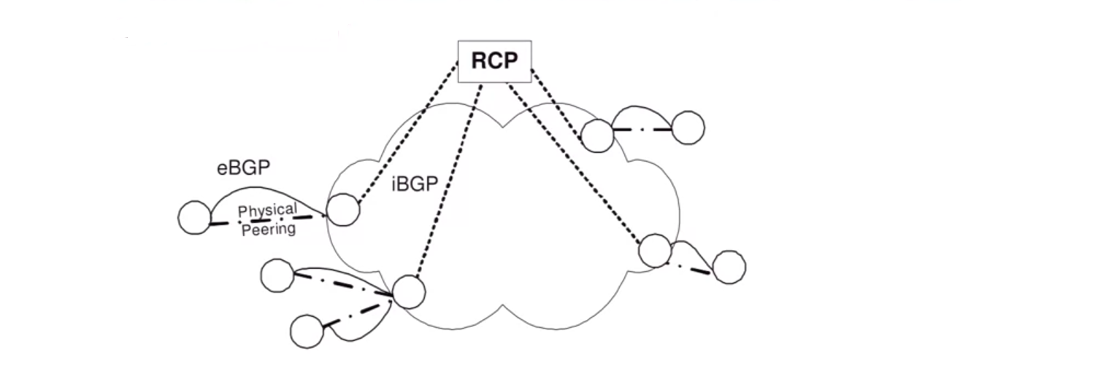
Evolution of SDN: Logically Centralized Control
Routing Control Platform (2005) [Caesar et al. NSDI 2005]
Centralized computing to BGP routes, pushed to border routers via iBGP
Software Defined Network

Slide 81
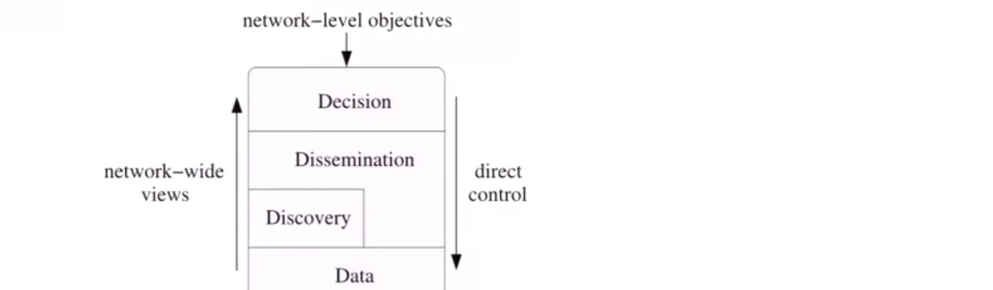
Evolution of SDN: Logically Centralized Control
4D architecture (2005)
A clean slate 4D Approach to Network control and management [Greensburg, Et. Al., CCR Oct 2005 ]
Logically centralized “decision plane” separated from data planes
Software Defined Network

Slide 82
Evolution of SDN: Logically Centralized Control
Ethane (2007) [Casado et al., SIGCOMM 2007]
Centralized controller enforces enterprise network Ethernet forwarding policy using existing hardware.
Software Defined Network

Slide 83
Evolution of SDN: Logically Centralized Control
OpenFlow (2008) [McKeown et al. 2008]
Thin standardized interface to data planes.
General purpose programmability at control.
Software Defined Network

Slide 84
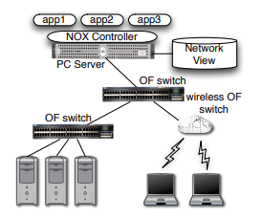
Evolution of SDN: Logically Centralized Control
Routing Control Platform (2005)
4D architecture (2005)
Ethane (2007)
OpenFlow (2008)
NOX (2008) [Gude et al. CCR 2008]
First OpenFlow (OF) controller: centralized network view provided to multiple control applications s as a database.
Handles state collection and distribution.
Industry explosion (~2010+)
Software Defined Network

Slide 85
SDN Opportunities
Open data plane interface
Hardware : with standardized API, easier for operators to change hardware, and for vendors to enter market
Software : can more directly access device behavior
Centralized controller:
Direct programmatic control of network
Software abstraction of the controller
Solves distributed systems problem only once, then just write algorithm.
Libraries/languages to help programmers write net apps
Systems to write high level policies instead of programming
Software Defined Network

Slide 86
Challenges of SDN
Performance and Scalability
Controlling the network through devices to respond quickly with latency concerns i.e. capacity concerns.
Distributed systems challenges still present
Network is fundamentally a distributed system
Resilience of logically centralized controllers
Imperfect knowledge of network state
Consistency issues between controllers
Software Defined Network

Slide 87
Architectural Challenges of SDN
Protocol to program the data planes
OpenFlow ? NFV function ? WhiteBox switching ?
Devising the right control abstraction ?
Programming OpenFlow : far too low level
But what are the right level abstractions to cover important use cases ?
Software Defined Network

Slide 88
The First Cloud Apps for SDN
Virtualization of multi-tenant data centers
Create separate virtual network for tenants
Allow flexible placement and movements of VMs
Inter-datacenter traffic engineering
Trying to achieve maximum utilization near 100% if possible.
Protect critical traffic from congestion.
Key-characteristics for above use cases
Special purpose deployments with less diverse hardware.
Existing solutions aren’t just inconvenient and don’t work.
Software Defined Network

Slide 89
Multi-tenant Data Centers : The challenges
Cloud is shared among multiple parties and gives economy of scale. To share the cloud among multiple tenants, there's bit more work to do. So the key needs for building a multi-tenant Cloud data center are:
(i) Agility
(ii) Location independent addressing
(iii) Performance uniformity
(iv) Security
(v) Network semantics
Software Defined Network

Slide 90
(i) Agility
Use any server for any service at any time:
Better economy of scale through increased utilization: Pack, compute as best we can for high utilization. If we ever have constraints then it's going to be a lot harder to make full use of resources.
Improved reliability: If there is a planned outage or an unexpected outage, move the services to keep running uninterrupted.
Service or tenant can means:
A customer renting space in a public cloud
Application or service in a private cloud as an internal customer
Software Defined Network

Slide 91
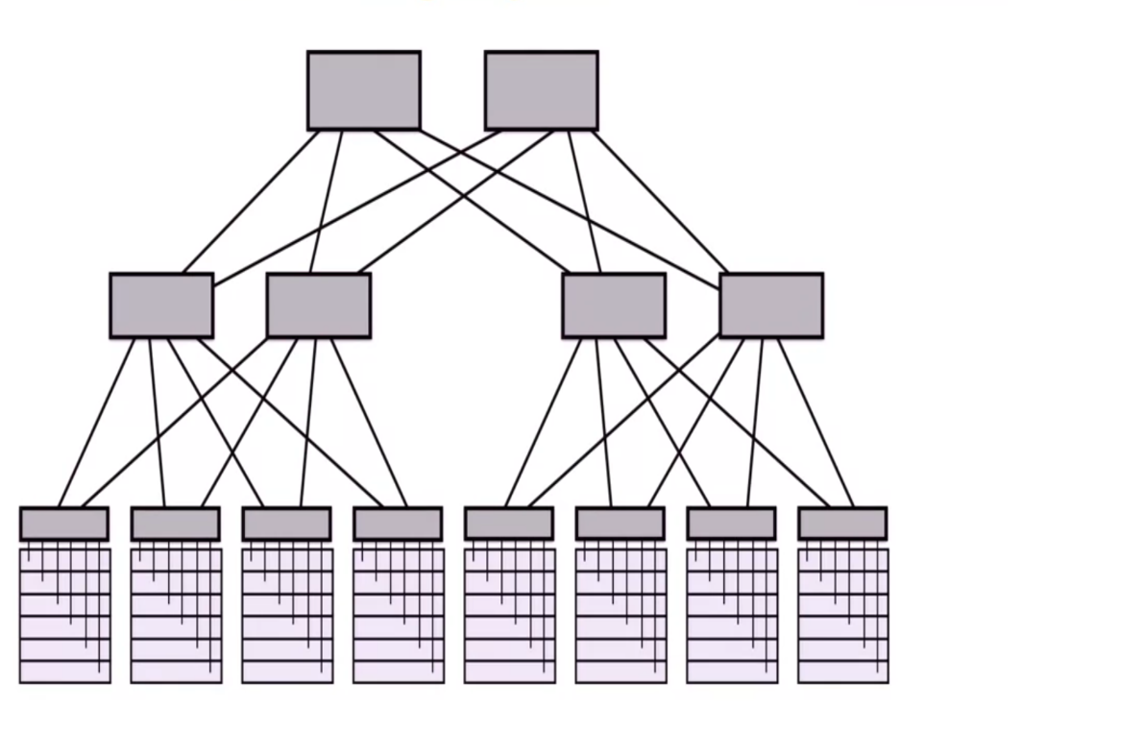
Traditional Datacenters
Routers
Aggregation switches
Top of Racks switches
Racks
Software Defined Network

Slide 92
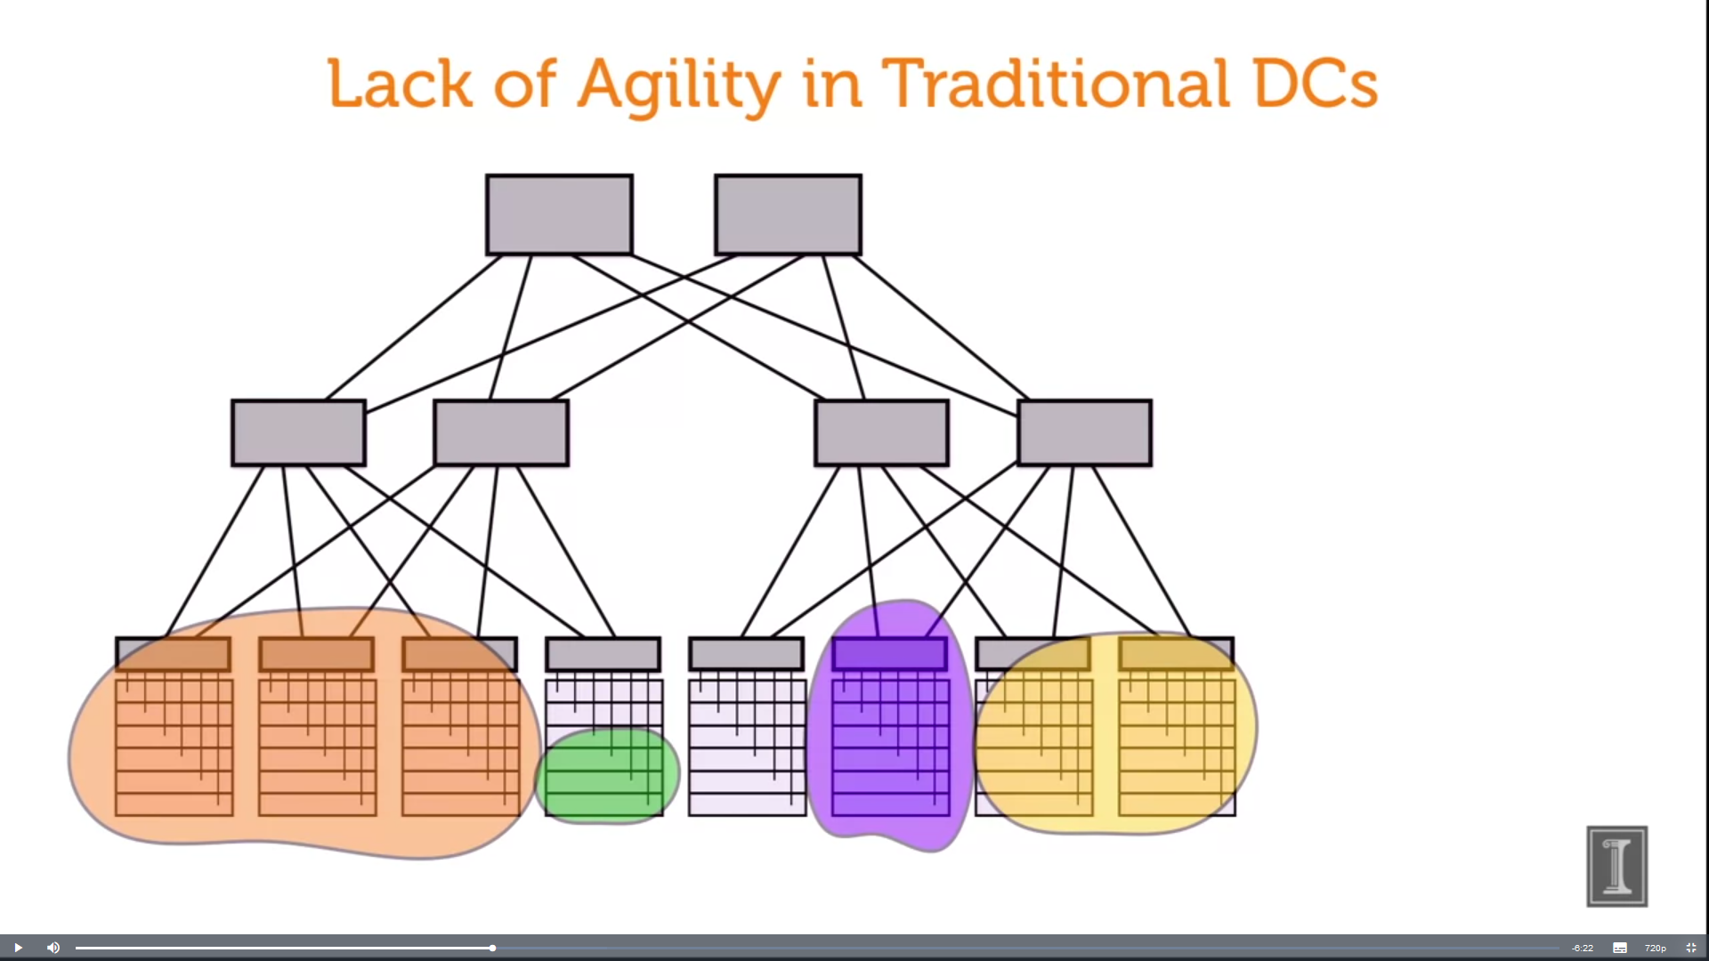
Lack of Agility in Traditional DCs
Tenant in “silos” – Means one rack or a part of the cluster is devoted to a particular service
Poor Utilization
Inability to expand
Software Defined Network

Slide 93
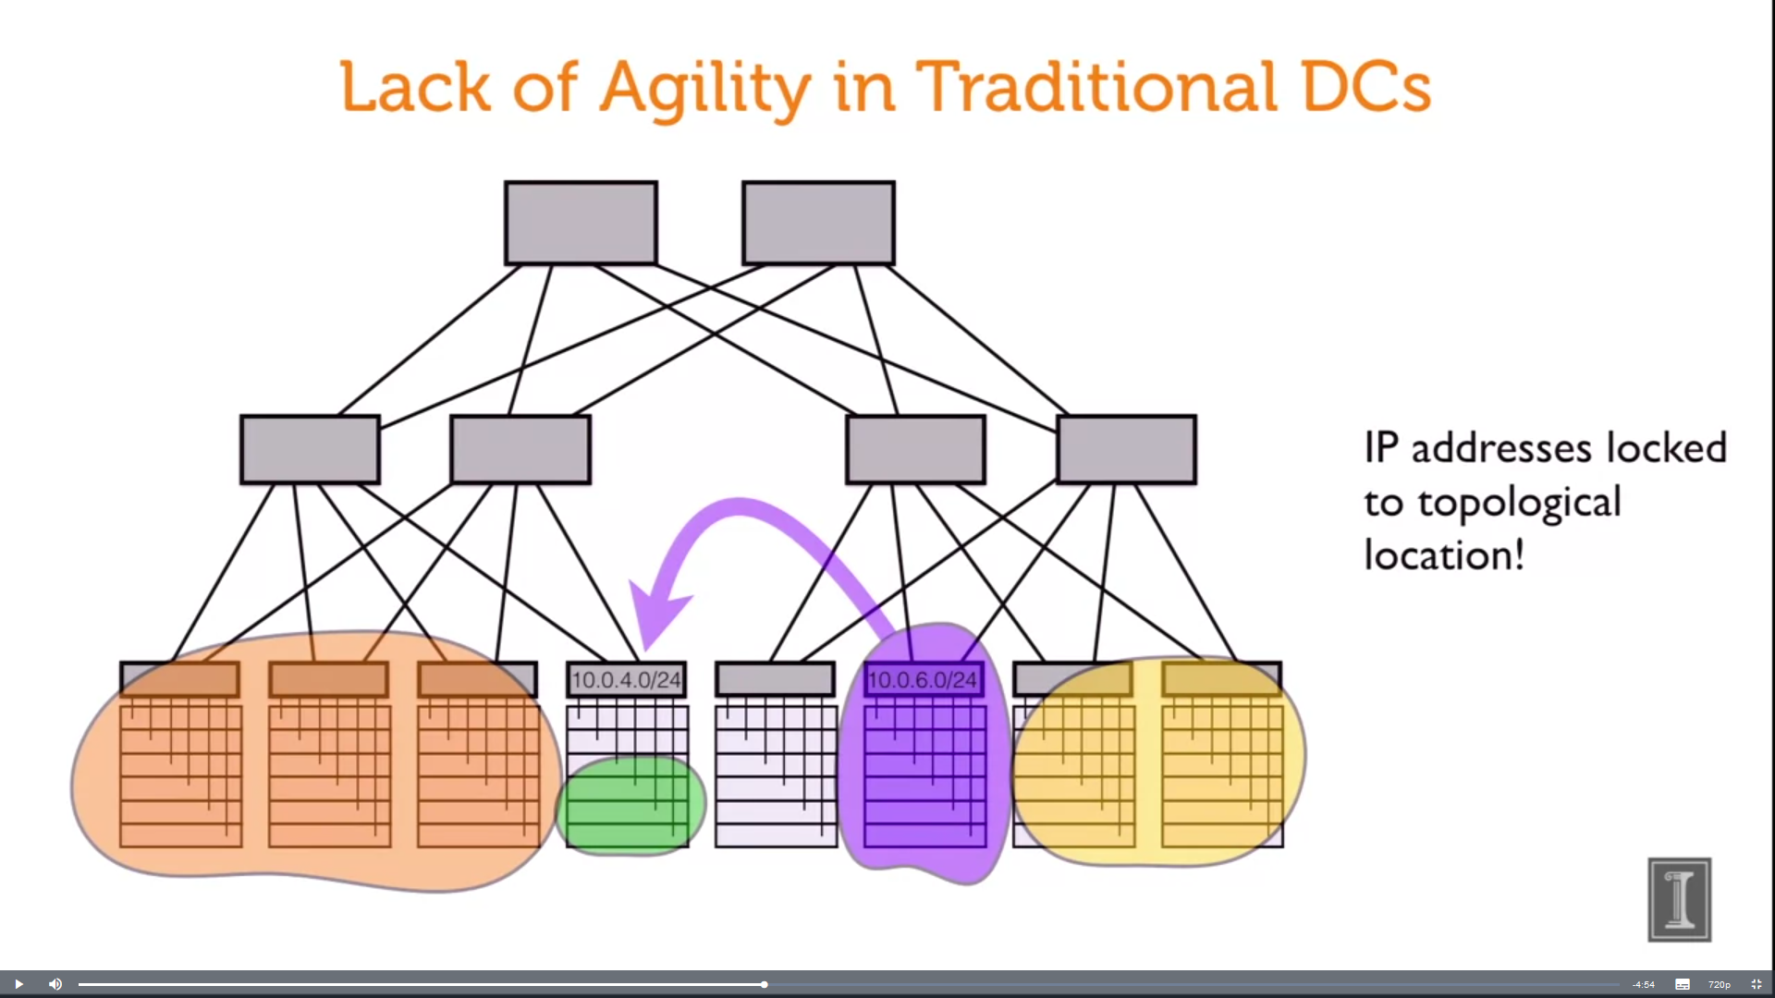
Lack of Agility in Traditional DCs
IP addresses locked to topological location!
Software Defined Network

Slide 94
Key needs: Agility
Agility
Location independent addressing: Racks are generally assigned different IP Subnets, because subnets are used as topological locators so that we can route. To move some service over there, we're going to have to change its IP address and it is hard to change the IP addresses of live running services.
Tenant’s IP address can be taken anywhere: Tenant's IP address to be taken anywhere, independent of the location and the data center without notify tenants that it has changed location. Large over subscription ratio i.e. 100 % or greater if there's a lot of communication between both sides will be about a hundred times lower throughput than communicating within the rack.
Software Defined Network

Slide 95
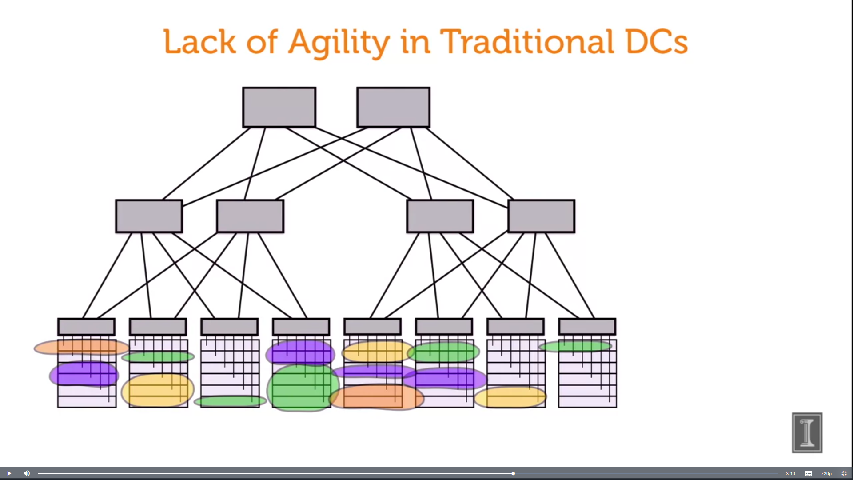
Key needs: Performance Uniformity
Performance Uniformity
Wherever the VMs are, they will see the same performance and latency.
Smaller units of compute that we've divided our services into, and put them anywhere in the data center, and may be on the same physical machine.
Smaller units of compute
Software Defined Network

Slide 96
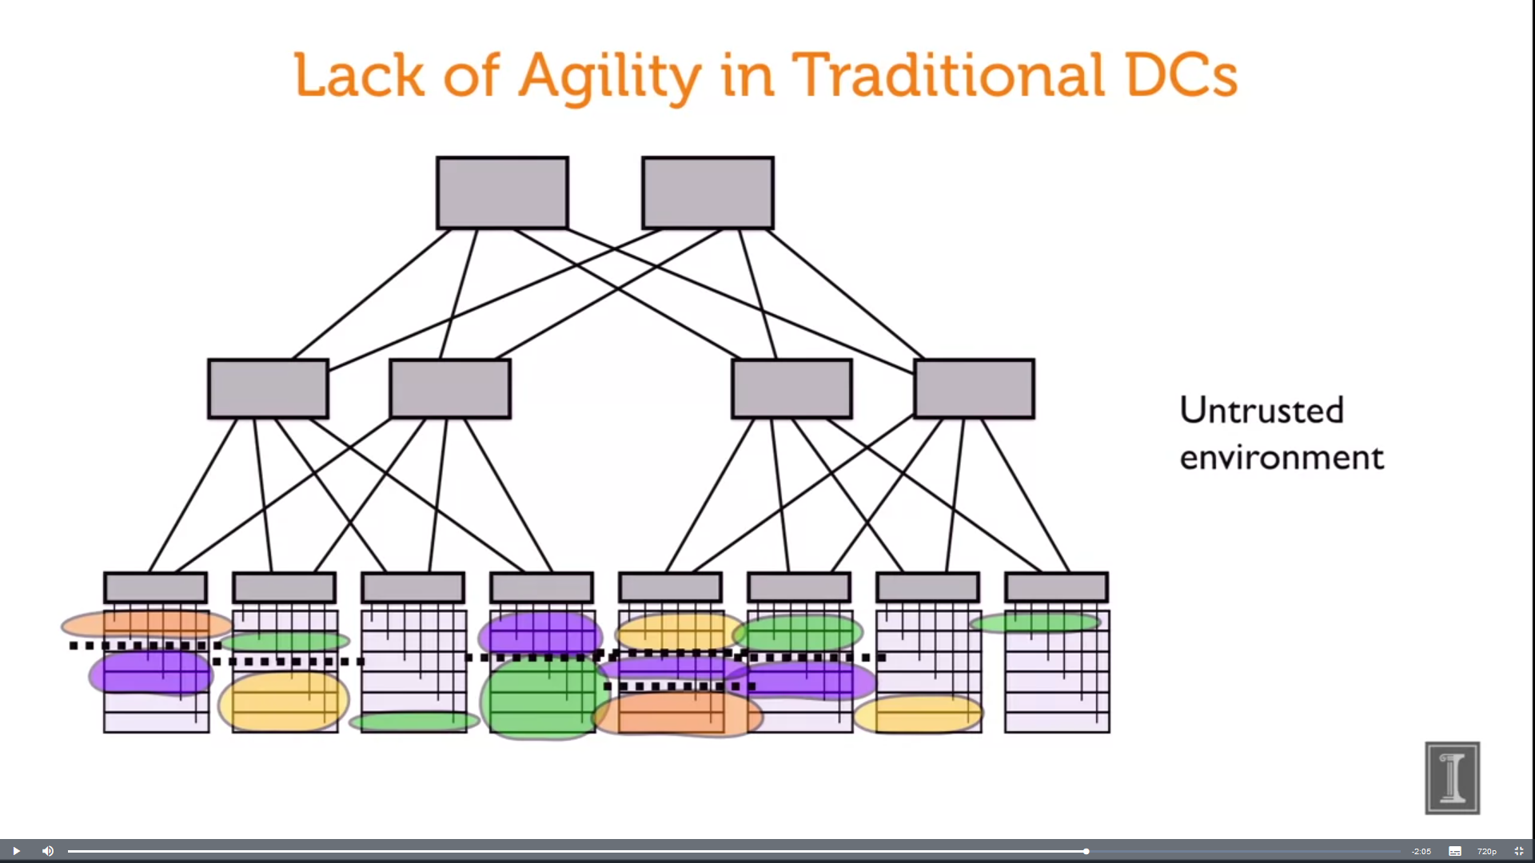
Key needs: Security
Security: Untrusting applications and users sitting right next to each other and can be inbound attacks. So to protect our tenants in the data center from each other in both the public data center as well as in the private cloud and you don't want them to have to trust each other.
Micro-segmentation : separation of different regions of a network.
Much finer grained division and control, of how data can flow.
Isolate or control just the data flow between pairs of applications, or tenants that should be actually allowed.
Software Defined Network

Slide 97
Key needs: Network semantics
Network semantics:
Match the functional service of a traditional data center
Not just Layer 3 routing services but also, Layer 2 services i.e. discovery services, multicast, broadcast etc. have to be supported.
Software Defined Network

Slide 98
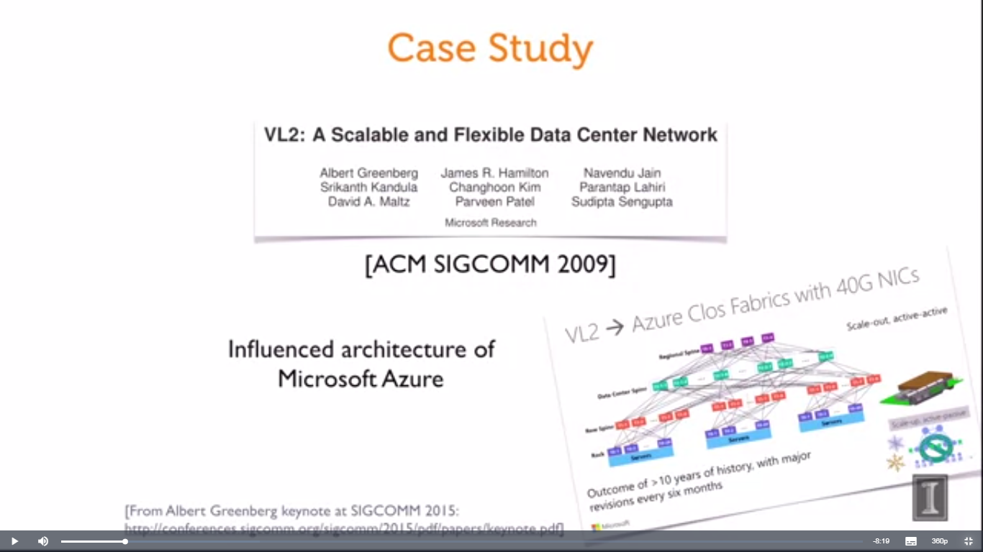
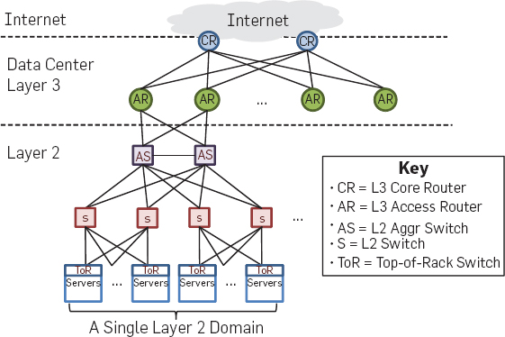
Network Virtualization in Multi-tenant Data Centers Case Study: VL2
Case Study: VL2

Slide 99
Network Virtualization Case Study: VL2
Key Needs:
(i) Agility
(ii) Location independent addressing
(iii) Performance uniformity
(iv) Security
(v) Network Semantics
Case Study: VL2

Slide 100
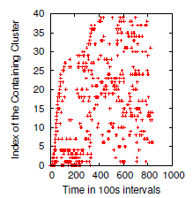
Motivating Environmental Characteristics
Increasing internal traffic is a bottleneck
Traffic volume between servers is 4 times larger than the external traffic
Rapidly-changing traffic matrices (TMs)
i.e. Take traffic matrices in 100 second buckets and classify them into 40 categories of similar clusters of traffic matrices and see which of the clusters appear in the measurements
So over time rapidly changing and no pattern to what the particular traffic matrix is.
Design result: Nonblocking fabric
High throughput for any traffic matrices that respects server NIC rates.
The fabric joining together all the servers, we don't want that to be a bottle neck.
[Greenberg et al.]
Case Study: VL2

Slide 101
Motivating Environmental Characteristics
Failure characteristics:
Analyzed 300K alarm tickets, 36 million error events from the cluster
0.4% of failures were resolved in over one day
0.3% of failures eliminated all redundancy in a device group (e.g. both uplinks)
Design result: Clos topology:
Particular kind of non blocking topology
“Scale out” instead of “scale up”
Case Study: VL2

Slide 102
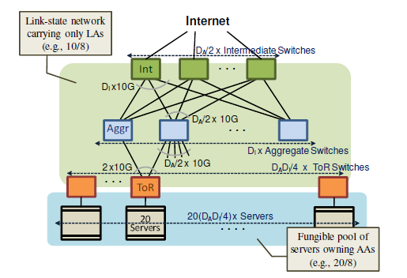
VL2 physical topology
Traditional
VL2
An example Clos network between Aggregation and Intermediate switches provides a richly-connected backbone well suited for VLB. .e network is built with two separate address families—topologically significant Locator Addresses (LAs) and at Application Addresses (AAs).
Figures from Greenberg et al.
Case Study: VL2

Slide 103
Routing in VL2
Unpredictable traffic
Means it is difficult to adapt. So this leads us to a design that is what's called oblivious routing. It means that the path along which we send a particular flow does not depend on the current traffic matrix.
Design result: “Valiant Load Balancing”
For routing on hyper cubes take an arbitrary traffic matrix and make it look like a completely uniform even traffic matrix.
Take flows and spreading evenly over all the available paths. Spread traffic as much as possible.
Route traffic independent of current traffic matrix
Case Study: VL2

Slide 104
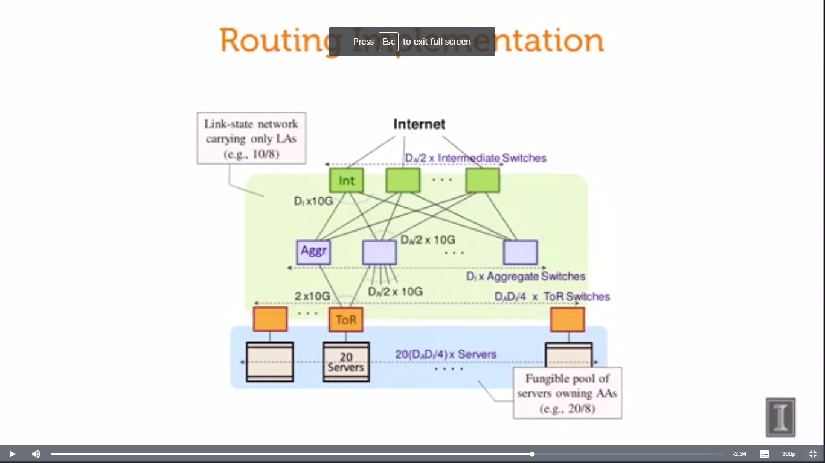
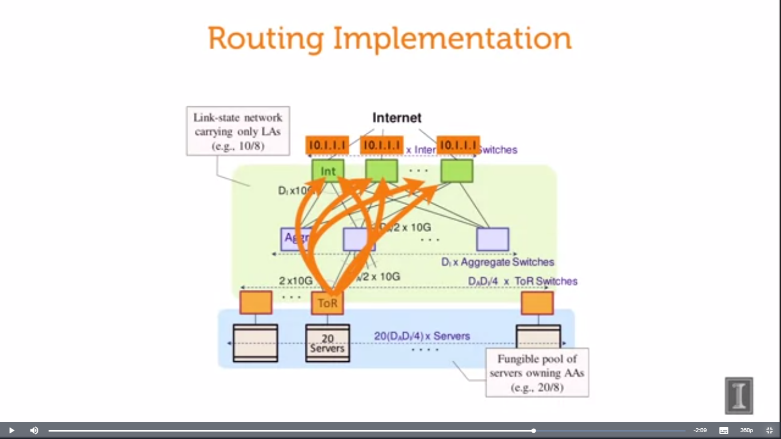
Routing Implementation
Spreads arbitrary traffic pattern so it’s uniform among top layer switches which are called intermediate switches.
Now to do that what VL2 does is it assigns those intermediate switches and any cast address. The same any cast address for all of the switches.
So, then a top of rack switch can send to a random one by just using that single address. And if we are using ECMP we will use a random one of those paths that are shortest.
Case Study: VL2

Slide 105
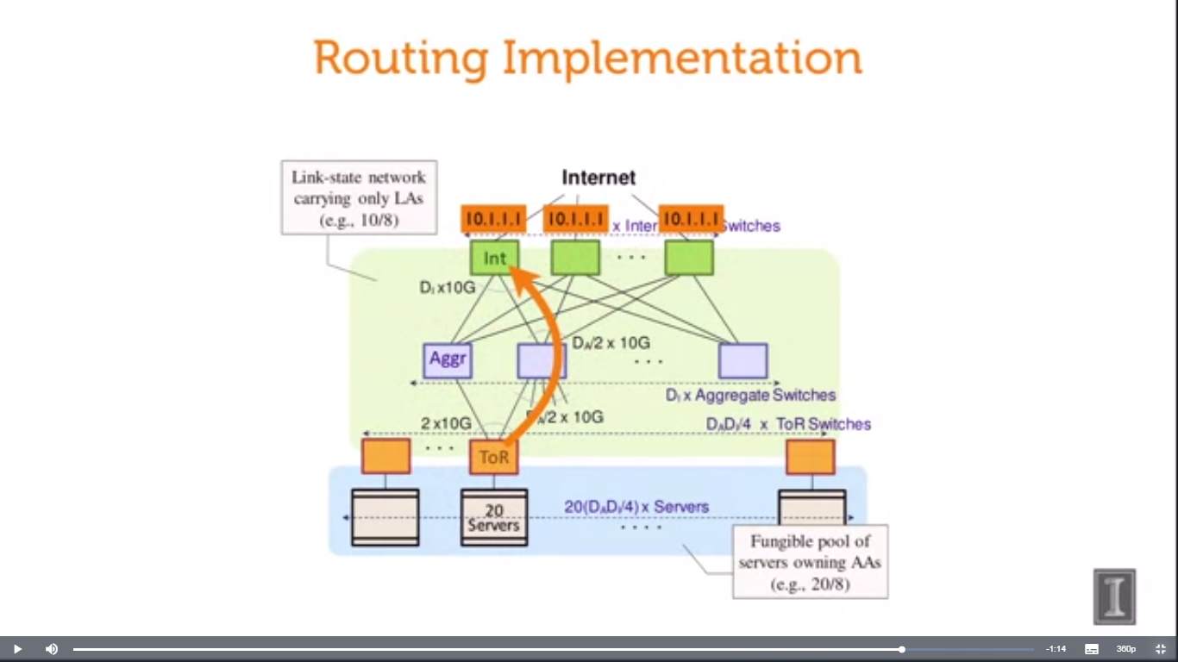
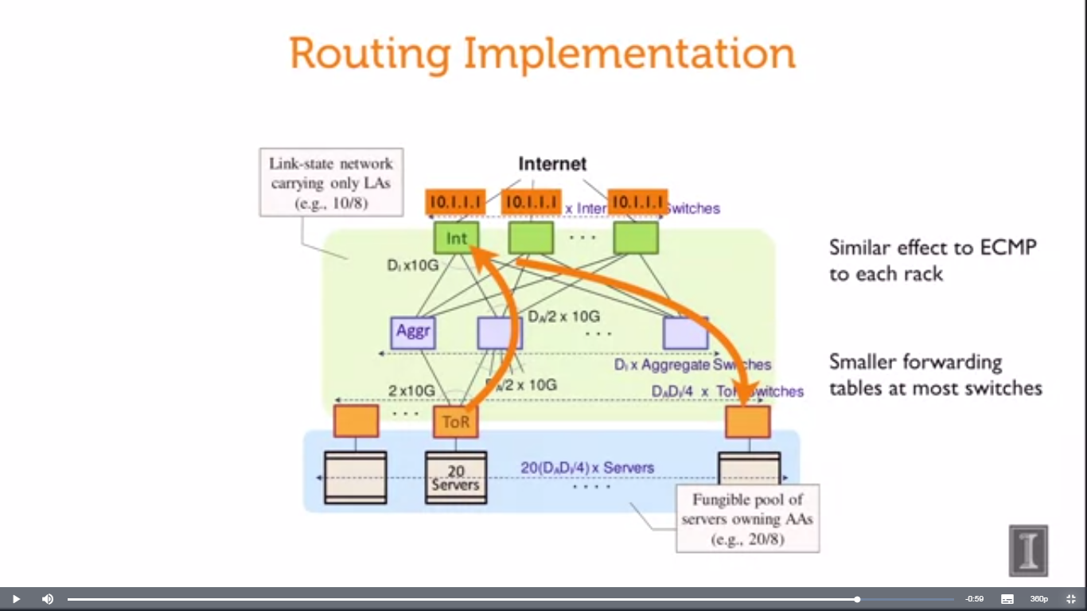
Routing Implementation
As all of the paths are shortest because all of those intermediate switches are the same distance from the top of racks, So ECMP is going to give the full breadth of possible paths to any one of those switches, just by naming the single anycast address of all of the intermediates.
ECMP lets us select from one of those paths then one will be picked from any particular flow. We send it to that intermediate switch. Now that outer anycast address is wrapping an inner header that actually has the destination address, in this design. So we'll forward it from there onto the destination.
Similar effect to ECMP to each rack
Smaller forwarding table at most switches
Case Study: VL2

Slide 106
Any service anywhere
Application or tenant of the data center is going to see what's called application addresses.
These are location independent, Same address no matter where the VM goes. And they're going to see the illusion of a single big Layer
2 switch connecting all of the application's VMs.
App/Tenant layer
Maintains a directory server that maps the application level addresses to their current locators.
VL2 has agents that run on the server that will query the directory server and find that AA to LA mapping. And then when it sends a packet, it'll wrap the application address in the outer locator header
Indirection or Virtualization layer
Different set of IP addresses called locator addresses.
Tied to topology used to route
Layer 3 routing via OSPF
Physical network layer
Case Study: VL2

Slide 107
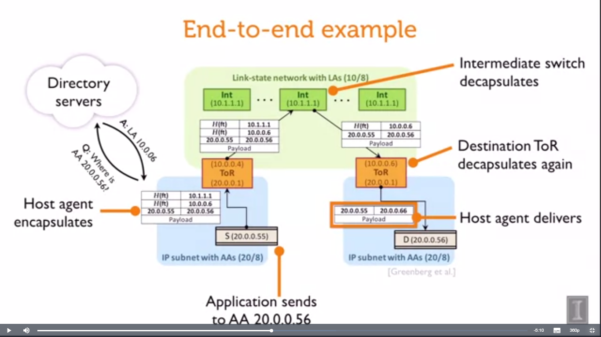
End-to-end Example
Case Study: VL2

Slide 108
Did we achieve agility?
Location independent addressing
AAs are location independent
L2 network semantics
Agent intercepts and handles L2 broadcast, multicast
Both of the above require “layer 2.5” shim agent running on host; but, concept transfers to hypervisor-based virtual switch
Case Study: VL2

Slide 109
Did we achieve agility?
Performance uniformity:
Clos network is nonblocking (non-oversubscribed)
Uniform capacity everywhere.
ECMP provides good (though not perfect) load balancing
But performance isolation among tenants depends on TCP backing off to the rate that the destination can receive.
Leaves open the possibility of fast load balancing
Security:
Directory system can allow/deny connections by choosing whether to resolve an AA to a LA
But, segmentation not explicitly enforced at hosts
Case Study: VL2

Slide 110
Where’s the SDN?
Directory servers: Logically centralized control
Orchestrate application locations
Control communication policy
Hosts agents: dynamic “programming” of data path
Case Study: VL2

Slide 111
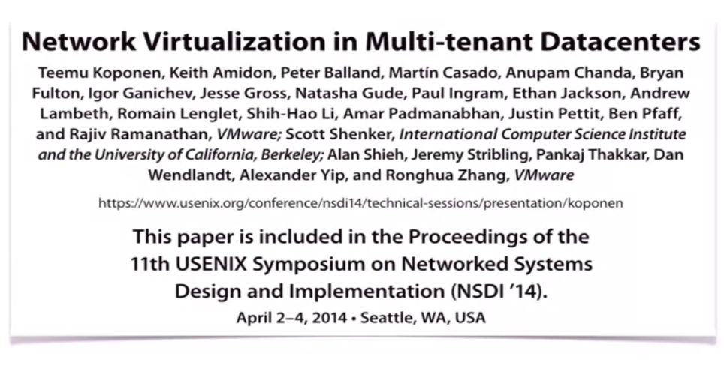
Network Virtualization Case Study: NVP
Case Study: NVP

Slide 112
NVP Approach to Virtualization
The network virtualization platform that was introduced in the paper “Network virtualization in Multi-tenant Datacenters” by Teemu Koponen et al. in NSDI 2014.
And this comes out of a product developed by the Nicira startup that was acquired by VMware.
Case Study: NVP

Slide 113
Service: Arbitrary network topology
Replicate arbitrary topology
Any standard layer 3 network
Network hypervisor
Virtual network tenants want to build
Network hypervisor
Physical Network: Any layer standard3 network
Case Study: NVP

Slide 114
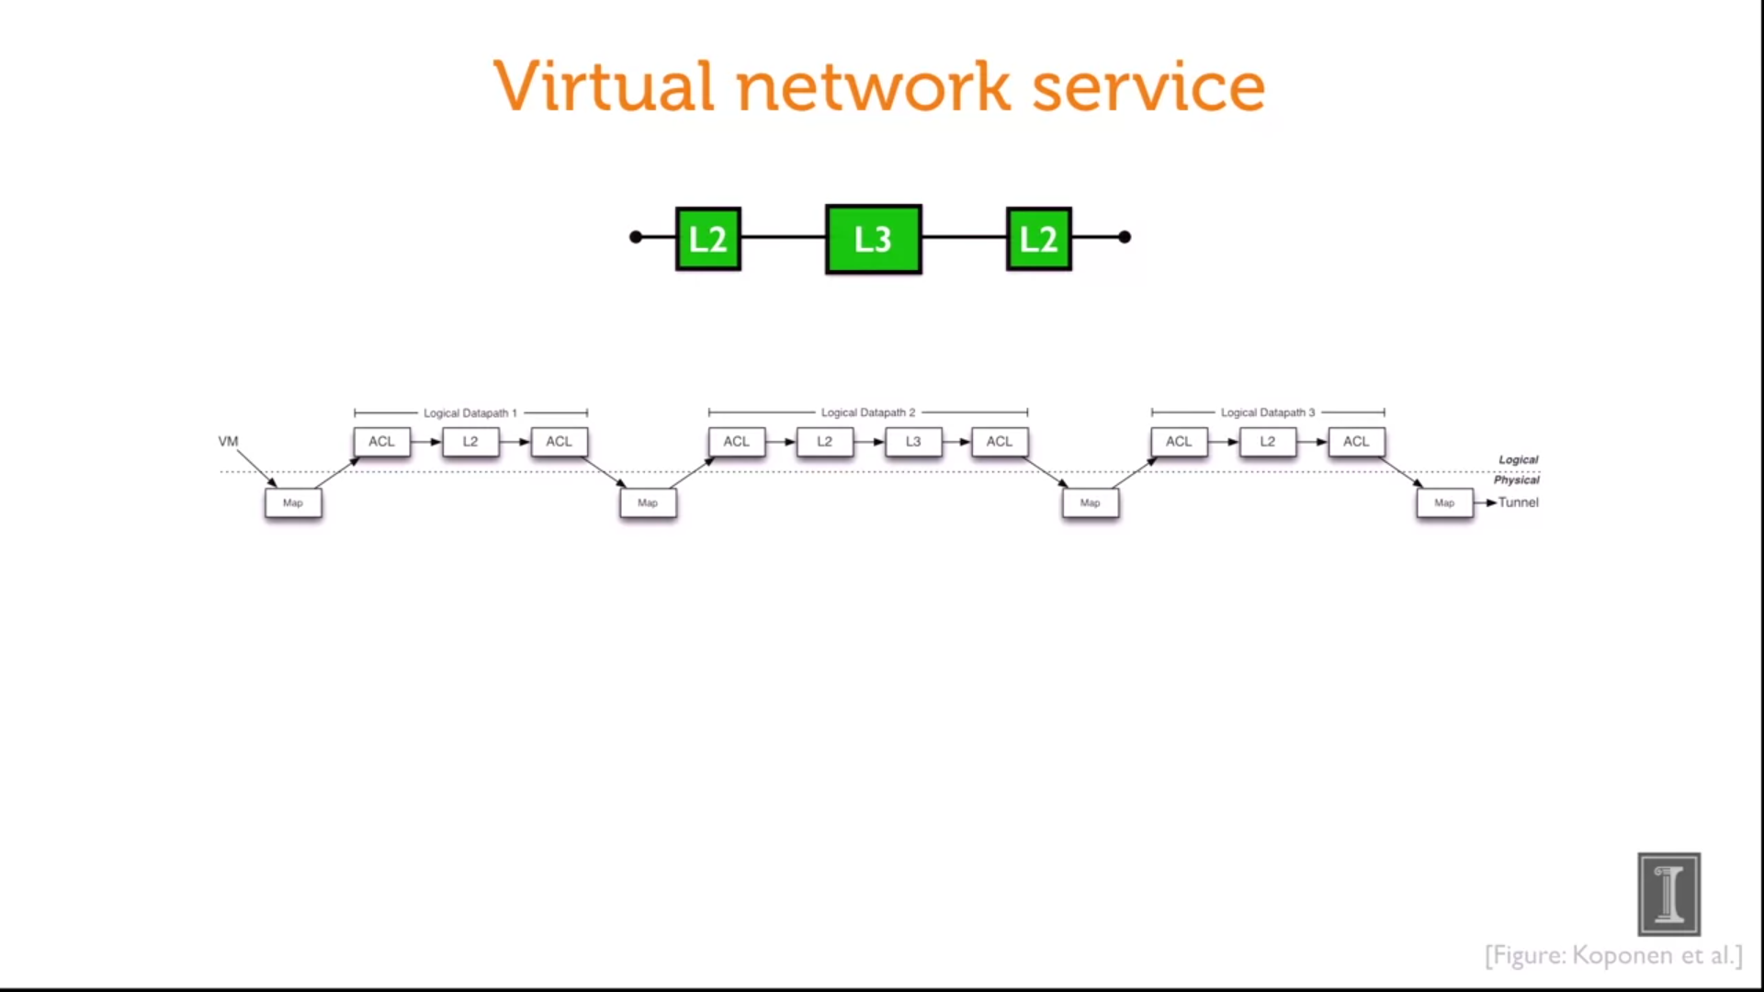
Virtual Network Service
Modeled as a sequence of data path elements that represent those switches.
And these data path elements, each one of them is a OpenFlow forwarding table.
It means the table will match on certain signature of packet headers and take certain resulting actions like dropping the packet, modifying certain fields in the packet, or forwarding the packet on.
So the idea's that we can model the switching, and routing gear with the right sequences of the right OpenFlow tables that we set up.
Access control Link Table
Case Study: NVP

Slide 115
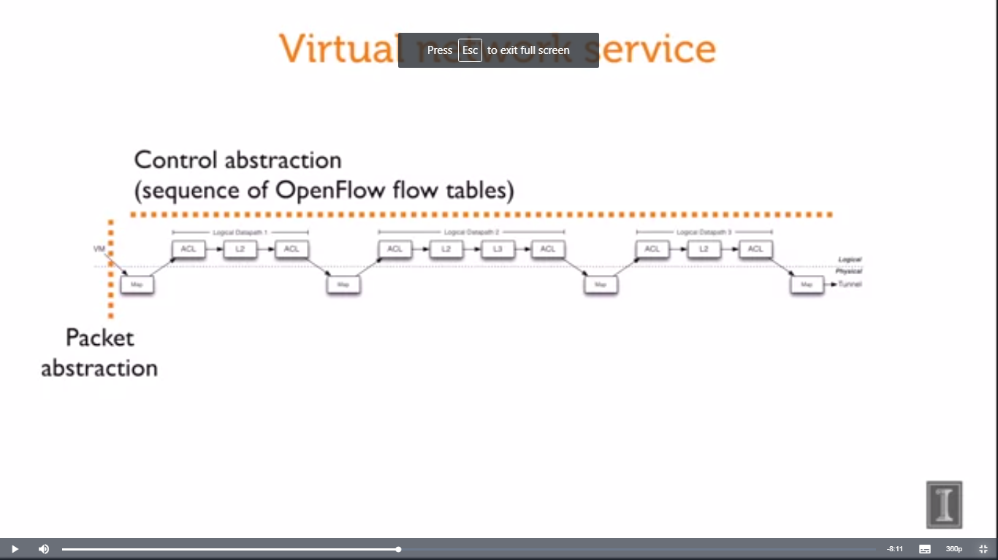
Virtual Network Service
There's a packet abstraction where virtual machines are able to inject traffic into the virtual network.
And there's a control abstraction where the tenant was able to define this entire virtual network pipeline, that sequence of OpenFlow flow tables.
That's the interface that the tenant is given, at least the lowest level interface, that the tenant is given to be able to program their virtual network.
Case Study: NVP

Slide 116

Case Study: NVP

Slide 117
Challenge: Performance
Large amount of state to compute
Full virtual network state at every host with a tenant VM!
O(n²) tunnels for tenant with n VMs
Solution 1: Automated incremental state computation with nlog declarative language
Solution 2: Logical controller computes single set of universal flows for a tenant, translated more locally by “physical controllers”
Case Study: NVP

Slide 118
Challenge: Performance
Pipeline processing in virtual switch can be slow
Solution: Send first packet of a flow through the full pipeline: thereafter, put an exact-match packet entry in the kernel
Tunneling interfaces with TCP Segmentation Offload (TSO)
NIC can’t see TCP outer header
Solution: STT tunnels adds “fake” outer TCP header
Case Study: NVP

Slide 119
Conclusion
In this lecture, we have discussed the need of software defined network, key ideas and challenges of software defined network.
We have also discussed the challenges in multi-tenant data centers i.e. (i) Agility, (ii) Location independent addressing (iii) Performance uniformity, (iv) Security and (v) Network semantics.
Then we have discussed the network Virtualization in multi-tenant data centers with a case study of VL2 and NVP
Case Study: NVP

Slide 120
Design of Key-Value Stores
Design of Key-Value Stores

Slide 121
Preface
Content of this Lecture:
In this lecture, we will discuss the design and insight of Key-value/NoSQL stores for today’s cloud storage systems.
We will also discuss one of the most popular cloud storage system i.e. Apache Cassandra and different consistency solutions.
Design of Key-Value Stores

Slide 122
The Key-value Abstraction
(Business) Key → Value
(flipkart.com) item number → information about it
(easemytrip.com) Flight number → information about flight, e.g., availability
(twitter.com) tweet id → information about tweet
(mybank.com) Account number → information about it
Design of Key-Value Stores

Slide 123
The Key-value Abstraction (2)
It’s a dictionary datastructure.
Insert, lookup, and delete by key
Example: hash table, binary tree
But distributed.
Seems familiar? Remember Distributed Hash tables (DHT) in P2P systems?
Key-value stores reuse many techniques from DHTs.
Design of Key-Value Stores

Slide 124
Is it a kind of database ?
Yes, kind of
Relational Database Management Systems (RDBMSs) have been around for ages
MySQL is the most popular among them
Data stored in tables
Schema-based, i.e., structured tables
Each row (data item) in a table has a primary key that is unique within that table
Queried using SQL (Structured Query Language)
Supports joins
Design of Key-Value Stores

Slide 125
Relational Database Example
users table
user_id | name | zipcode | blog_url | blog_id
110 | Smith | 98765 | smith.com | 11
331 | Antony | 54321 | antony.in | 12
767 | John | 75676 | john.net | 13
Example SQL queries
SELECT zipcode
FROM users
WHERE name = “John”
2. SELECT url
FROM blog
WHERE id = 11
SELECT users.zipcode, blog.num_posts
FROM users JOIN blog
ON users.blog_url = blog.url
Primary keys
Foreign keys
blog table
Id | url | last_updated | num_posts
11 | smith.com | 9/7/17 | 991
13 | john.net | 4/2/18 | 57
12 | antony.in | 15/6/16 | 1090
Design of Key-Value Stores

Slide 126
Mismatch with today’s workloads
Data: Large and unstructured: Difficult to come out with schemas where the data can fit
Lots of random reads and writes: Coming from millions of clients.
Sometimes write-heavy: Lot more writes compare to read
Foreign keys rarely needed
Joins infrequent
Design of Key-Value Stores

Slide 127
Needs of Today’s Workloads
Speed
Avoid Single point of Failure (SPoF)
Low TCO (Total cost of operation and Total cost of ownership)
Fewer system administrators
Incremental Scalability
Scale out, not scale up
Design of Key-Value Stores

Slide 128
Scale out, not Scale up
Scale up = grow your cluster capacity by replacing with more powerful machines
Traditional approach
Not cost-effective, as you’re buying above the sweet spot on the price curve
And you need to replace machines often
Scale out = incrementally grow your cluster capacity by adding more COTS machines (Components Off the Shelf)
Cheaper
Over a long duration, phase in a few newer (faster) machines as you phase out a few older machines
Used by most companies who run datacenters and clouds today
Design of Key-Value Stores

Slide 129
Key-value/NoSQL Data Model
NoSQL = “Not Only SQL”
Necessary API operations: get(key) and put(key, value)
And some extended operations, e.g., “CQL” in Cassandra key-value store
Tables
“Column families” in Cassandra, “Table” in HBase, “Collection” in MongoDB
Like RDBMS tables, but …
May be unstructured: May not have schemas
Some columns may be missing from some rows
Don’t always support joins or have foreign keys
Can have index tables, just like RDBMSs
Design of Key-Value Stores

Slide 130
Key-value/NoSQL Data Model
Value
Key
Unstructured
No schema imposed
Columns missing from some Rows
No foreign keys, joins may not be supported
users table
user_id | name | zipcode | blog_url
110 | Smith | 98765 | smith.com
331 | Antony |  | antony.in
767 |  | 75676 | john.net
Value
blog table
Id | url | last_updated | num_posts
11 | smith.com | 9/7/17 | 991
13 | john.net |  | 57
12 | antony.in | 15/6/16
Design of Key-Value Stores

Slide 131
Column-Oriented Storage
NoSQL systems often use column-oriented storage
RDBMSs store an entire row together (on disk or at a server)
NoSQL systems typically store a column together (or a group of columns).
Entries within a column are indexed and easy to locate, given a key (and vice-versa)
Why useful?
Range searches within a column are fast since you don’t need to fetch the entire database
E.g., Get me all the blog_ids from the blog table that were updated within the past month
Search in the the last_updated column, fetch corresponding blog_id column
Don’t need to fetch the other columns
Design of Key-Value Stores

Slide 132
Design of Apache Cassandra
Design of Apache Cassandra

Slide 133
Cassandra
A distributed key-value store
Intended to run in a datacenter (and also across DCs)
Originally designed at Facebook
Open-sourced later, today an Apache project
Some of the companies that use Cassandra in their production clusters
Blue chip companies: IBM, Adobe, HP, eBay, Ericsson
Newer companies: Twitter
Nonprofit companies: PBS Kids
Netflix: uses Cassandra to keep track of positions in the video.
Design of Apache Cassandra

Slide 134
Inside Cassandra: Key -> Server Mapping
How do you decide which server(s) a key-value resides on?
Design of Apache Cassandra

Slide 135
0
One ring per DC
Say m=7
N112
N16
(Remember this?)
Primary replica for
key K13
N96
Read/write K13
N32
N80
N45
Client
Coordinator
Backup replicas for
key K13
Cassandra uses a Ring-based DHT but without finger tables or routing
Key→server mapping is the “Partitioner”
Design of Apache Cassandra

Slide 136
Data Placement Strategies
Replication Strategy:
SimpleStrategy
NetworkTopologyStrategy
SimpleStrategy: uses the Partitioner, of which there are two kinds
RandomPartitioner: Chord-like hash partitioning
ByteOrderedPartitioner: Assigns ranges of keys to servers.
Easier for range queries (e.g., Get me all twitter users starting with [a-b])
NetworkTopologyStrategy: for multi-DC deployments
Two replicas per DC
Three replicas per DC
Per DC
First replica placed according to Partitioner
Then go clockwise around ring until you hit a different rack
Design of Apache Cassandra

Slide 137
Snitches
Maps: IPs to racks and DCs. Configured in cassandra.yaml config file
Some options:
SimpleSnitch: Unaware of Topology (Rack-unaware)
RackInferring: Assumes topology of network by octet of server’s IP address
101.102.103.104 = x.<DC octet>.<rack octet>.<node octet>
PropertyFileSnitch: uses a config file
EC2Snitch: uses EC2.
EC2 Region = DC
Availability zone = rack
Other snitch options available
Design of Apache Cassandra

Slide 138
Writes
Need to be lock-free and fast (no reads or disk seeks)
Client sends write to one coordinator node in Cassandra cluster
Coordinator may be per-key, or per-client, or per-query
Per-key Coordinator ensures writes for the key are serialized
Coordinator uses Partitioner to send query to all replica nodes responsible for key
When X replicas respond, coordinator returns an acknowledgement to the client
X?
Design of Apache Cassandra

Slide 139
Writes (2)
Always writable: Hinted Handoff mechanism
If any replica is down, the coordinator writes to all other replicas, and keeps the write locally until down replica comes back up.
When all replicas are down, the Coordinator (front end) buffers writes (for up to a few hours).
One ring per datacenter
Per-DC coordinator elected to coordinate with other DCs
Election done via Zookeeper, which runs a Paxos (consensus) variant
Design of Apache Cassandra

Slide 140
Writes at a replica node
On receiving a write
1. Log it in disk commit log (for failure recovery)
2. Make changes to appropriate memtables
Memtable = In-memory representation of multiple key-value pairs
Typically append-only datastructure (fast)
Cache that can be searched by key
Write-back aas opposed to write-through
Later, when memtable is full or old, flush to disk
Data File: An SSTable (Sorted String Table) – list of key-value pairs, sorted by key
SSTables are immutable (once created, they don’t change)
Index file: An SSTable of (key, position in data sstable) pairs
And a Bloom filter (for efficient search)
Design of Apache Cassandra

Slide 141
Bloom Filter
Compact way of representing a set of items
Checking for existence in set is cheap
Some probability of false positives: an item not in set may check true as being in set
Never false negatives
Large Bit Map
0
1
On insert, set all hashed bits.
On check-if-present,
return true if all hashed bits set.
False positives
False positive rate low
m=4 hash functions
100 items
3200 bits
FP rate = 0.02%
2
3
Hash1
Key-K
Hash2
69
.
.
Hashk
111
127
Design of Apache Cassandra

Slide 142
Compaction
Data updates accumulate over time and SStables and logs need to be compacted
The process of compaction merges SSTables, i.e., by merging updates for a key
Run periodically and locally at each server
Design of Apache Cassandra

Slide 143
Deletes
Delete: don’t delete item right away
Add a tombstone to the log
Eventually, when compaction encounters tombstone it will delete item
Design of Apache Cassandra

Slide 144
Reads
Read: Similar to writes, except
Coordinator can contact X replicas (e.g., in same rack)
Coordinator sends read to replicas that have responded quickest in past
When X replicas respond, coordinator returns the latest-timestamped value from among those X
(X? We will check it later. )
Coordinator also fetches value from other replicas
Checks consistency in the background, initiating a read repair if any two values are different
This mechanism seeks to eventually bring all replicas up to date
At a replica
A row may be split across multiple SSTables => reads need to touch multiple SSTables => reads slower than writes (but still fast)
Design of Apache Cassandra

Slide 145
Membership
Any server in cluster could be the coordinator
So every server needs to maintain a list of all the other servers that are currently in the server
List needs to be updated automatically as servers join, leave, and fail
Design of Apache Cassandra

Slide 146
Cluster Membership – Gossip-Style
Cassandra uses gossip-based cluster membership
1 | 10118 | 64
2 | 10110 | 64
3 | 10090 | 58
4 | 10111 | 65
1 | 10120 | 66
2 | 10103 | 62
3 | 10098 | 63
4 | 10111 | 65
2
1
Address
Time (local)
1 | 10120 | 70
2 | 10110 | 64
3 | 10098 | 70
4 | 10111 | 65
Heartbeat Counter
4
Protocol:
Nodes periodically gossip their membership list
On receipt, the local membership list is updated, as shown
If any heartbeat older than Tfail, node is marked as failed
3
Current time : 70 at node 2
(asynchronous clocks)
(Remember this?)
Design of Apache Cassandra

Slide 147
Suspicion Mechanisms in Cassandra
Suspicion mechanisms to adaptively set the timeout based on underlying network and failure behavior
Accrual detector: Failure Detector outputs a value (PHI) representing suspicion
Applications set an appropriate threshold
PHI calculation for a member
Inter-arrival times for gossip messages
PHI(t) =
– log(CDF or Probability(t_now – t_last))/log 10
PHI basically determines the detection timeout, but takes into account historical inter-arrival time variations for gossiped heartbeats
In practice, PHI = 5 => 10-15 sec detection time
Design of Apache Cassandra

Slide 148
Cassandra Vs. RDBMS
MySQL is one of the most popular (and has been for a while)
On > 50 GB data
MySQL
Writes 300 ms avg
Reads 350 ms avg
Cassandra
Writes 0.12 ms avg
Reads 15 ms avg
Orders of magnitude faster
What’s the catch? What did we lose?
Design of Apache Cassandra

Slide 149
CAP Theorem
CAP Theorem

Slide 150
CAP Theorem
Proposed by Eric Brewer (Berkeley)
Subsequently proved by Gilbert and Lynch (NUS and MIT)
In a distributed system you can satisfy atmost 2 out of the 3 guarantees:
Consistency: all nodes see same data at any time, or reads return latest written value by any client
Availability: the system allows operations all the time, and operations return quickly
Partition-tolerance: the system continues to work in spite of network partitions
CAP Theorem

Slide 151
Why is Availability Important?
Availability = Reads/writes complete reliably and quickly.
Measurements have shown that a 500 ms increase in latency for operations at Amazon.com or at Google.com can cause a 20% drop in revenue.
At Amazon, each added millisecond of latency implies a $6M yearly loss.
User cognitive drift: If more than a second elapses between clicking and material appearing, the user’s mind is already somewhere else
SLAs (Service Level Agreements) written by providers predominantly deal with latencies faced by clients.
CAP Theorem

Slide 152
Why is Consistency Important?
Consistency = all nodes see same data at any time, or reads return latest written value by any client.
When you access your bank or investment account via multiple clients (laptop, workstation, phone, tablet), you want the updates done from one client to be visible to other clients.
When thousands of customers are looking to book a flight, all updates from any client (e.g., book a flight) should be accessible by other clients.
CAP Theorem

Slide 153
Why is Partition-Tolerance Important?
Partitions can happen across datacenters when the Internet gets disconnected
Internet router outages
Under-sea cables cut
DNS not working
Partitions can also occur within a datacenter, e.g., a rack switch outage
Still desire system to continue functioning normally under this scenario
CAP Theorem

Slide 154
CAP Theorem Fallout
Since partition-tolerance is essential in today’s cloud computing systems, CAP theorem implies that a system has to choose between consistency and availability
Cassandra
Eventual (weak) consistency, Availability, Partition-tolerance
Traditional RDBMSs
Strong consistency over availability under a partition
CAP Theorem

Slide 155
CAP Tradeoff
Starting point for NoSQL Revolution
A distributed storage system can achieve at most two of C, A, and P.
When partition-tolerance is important, you have to choose between consistency and availability
Consistency
HBase, HyperTable,
BigTable, Spanner
RDBMSs
(non-replicated)
Pick 2
Partition-tolerance
Availability
Cassandra, RIAK,
Dynamo, Voldemort
CAP Theorem

Slide 156
Eventual Consistency
If all writes stop (to a key), then all its values (replicas) will converge eventually.
If writes continue, then system always tries to keep converging.
Moving “wave” of updated values lagging behind the latest values sent by clients, but always trying to catch up.
May still return stale values to clients (e.g., if many back-to-back writes).
But works well when there a few periods of low writes – system converges quickly.
CAP Theorem

Slide 157
RDBMS vs. Key-value stores
While RDBMS provide ACID
Atomicity
Consistency
Isolation
Durability
Key-value stores like Cassandra provide BASE
Basically Available Soft-state Eventual Consistency
Prefers Availability over Consistency
CAP Theorem

Slide 158
Consistency in Cassandra
Cassandra has consistency levels
Client is allowed to choose a consistency level for each operation (read/write)
ANY: any server (may not be replica)
Fastest: coordinator caches write and replies quickly to client
ALL: all replicas
Ensures strong consistency, but slowest
ONE: at least one replica
Faster than ALL, but cannot tolerate a failure
QUORUM: quorum across all replicas in all datacenters (DCs)
What?
CAP Theorem

Slide 159
Quorums for Consistency
In a nutshell:
Quorum = majority
> 50%
Any two quorums intersect
Client 1 does a write in red quorum
Then client 2 does read in blue quorum
At least one server in blue quorum returns latest write
Quorums faster than ALL, but still ensure strong consistency
A second
quorum
A quorum
A server
Five replicas of a key-value pair
CAP Theorem

Slide 160
Quorums in Detail
Several key-value/NoSQL stores (e.g., Riak and Cassandra) use quorums.
Reads
Client specifies value of R (≤ N = total number of replicas of that key).
R = read consistency level.
Coordinator waits for R replicas to respond before sending result to client.
In background, coordinator checks for consistency of remaining (N-R) replicas, and initiates read repair if needed.
CAP Theorem

Slide 161
Quorums in Detail (Contd..)
Writes come in two flavors
Client specifies W (≤ N)
W = write consistency level.
Client writes new value to W replicas and returns. Two flavors:
Coordinator blocks until quorum is reached.
Asynchronous: Just write and return.
CAP Theorem

Slide 162
Quorums in Detail (Contd.)
R = read replica count, W = write replica count
Two necessary conditions:
W+R > N
W > N/2
Select values based on application
(W=1, R=1): very few writes and reads
(W=N, R=1): great for read-heavy workloads
(W=N/2+1, R=N/2+1): great for write-heavy workloads
(W=1, R=N): great for write-heavy workloads with mostly one client writing per key
CAP Theorem

Slide 163
Cassandra Consistency Levels (Contd.)
Client is allowed to choose a consistency level for each operation (read/write)
ANY: any server (may not be replica)
Fastest: coordinator may cache write and reply quickly to client
ALL: all replicas
Slowest, but ensures strong consistency
ONE: at least one replica
Faster than ALL, and ensures durability without failures
QUORUM: quorum across all replicas in all datacenters (DCs)
Global consistency, but still fast
LOCAL_QUORUM: quorum in coordinator’s DC
Faster: only waits for quorum in first DC client contacts
EACH_QUORUM: quorum in every DC
Lets each DC do its own quorum: supports hierarchical replies
CAP Theorem

Slide 164
Types of Consistency
Cassandra offers Eventual Consistency
Are there other types of weak consistency models?
CAP Theorem

Slide 165
Consistency Solutions
Consistency Solutions

Slide 166

Consistency Solutions
Faster reads and writes
More consistency
Strong
(e.g., Sequential)
Eventual
Consistency Solutions

Slide 167
Eventual Consistency
Cassandra offers Eventual Consistency
If writes to a key stop, all replicas of key will converge
Originally from Amazon’s Dynamo and LinkedIn’s Voldemort systems
Faster reads and writes
More consistency
Strong
(e.g., Sequential)
Eventual
Consistency Solutions

Slide 168
Newer Consistency Models
Striving towards strong consistency
While still trying to maintain high availability and partition-tolerance
Red-Blue
Causal
Probabilistic
Per-key sequential
Strong
(e.g., Sequential)
Eventual
CRDTs
Consistency Solutions

Slide 169
Newer Consistency Models (Contd.)
Per-key sequential: Per key, all operations have a global order
CRDTs (Commutative Replicated Data Types): Data structures for which commutated writes give same result [INRIA, France]
E.g., value == int, and only op allowed is +1
Effectively, servers don’t need to worry about consistency
Red-Blue
Causal
Probabilistic
Per-key sequential
Strong
(e.g., Sequential)
Eventual
CRDTs
Consistency Solutions

Slide 170
Newer Consistency Models (Contd.)
Red-blue Consistency: Rewrite client transactions to separate operations into red operations vs. blue operations [MPI-SWS Germany]
Blue operations can be executed (commutated) in any order across DCs
Red operations need to be executed in the same order at each DC
Red-Blue
Causal
Probabilistic
Per-key sequential
Strong
(e.g., Sequential)
Eventual
CRDTs
Consistency Solutions

Slide 171
Newer Consistency Models (Contd.)
Causal Consistency: Reads must respect partial order based on information flow [Princeton, CMU]
W(K1, 33)
Client A
W(K2, 55)
Client B
Time
R(K1) returns 33
Client C
W(K1, 22)
R(K1) may return
22 or 33
R(K1) must return 33
R(K2) returns 55
Causality, not messages
Red-Blue
Causal
Probabilistic
Per-key sequential
Strong
(e.g., Sequential)
Eventual
CRDTs
Consistency Solutions

Slide 172
Which Consistency Model should you use?
Use the lowest consistency (to the left) consistency model that is “correct” for your application
Gets you fastest availability
Red-Blue
Causal
Probabilistic
Per-key sequential
Strong
(e.g., Sequential)
Eventual
CRDTs
Consistency Solutions

Slide 173
Strong Consistency Models
Linearizability: Each operation by a client is visible (or available) instantaneously to all other clients
Instantaneously in real time
Sequential Consistency [Lamport]:
"... the result of any execution is the same as if the operations of all the processors were executed in some sequential order, and the operations of each individual processor appear in this sequence in the order specified by its program.
After the fact, find a “reasonable” ordering of the operations (can re-order operations) that obeys sanity (consistency) at all clients, and across clients.
Transaction ACID properties, example: newer key-value/NoSQL stores (sometimes called “NewSQL”)
Hyperdex [Cornell]
Spanner [Google]
Transaction chains [Microsoft Research]
Consistency Solutions

Slide 174
Conclusion
Traditional Databases (RDBMSs) work with strong consistency, and offer ACID
Modern workloads don’t need such strong guarantees, but do need fast response times (availability)
Unfortunately, CAP theorem
Key-value/NoSQL systems offer BASE [Basically Available Soft-state Eventual Consistency]
Eventual consistency, and a variety of other consistency models striving towards strong consistency
We have also discussed the design of Cassandra and different consistency solutions.
Consistency Solutions

